Slide 1
SuDocu: Summarizing Documents by Example
Anna Fariha
Matteo Brucato
Peter J Haas
Alexandra Meliou
College of Information and Computer Sciences
University of Massachusetts Amherst
Notes:
Hi, I am Anna Fariha from University of Massachusetts, Amherst. This is a joint work with Matteo Brucato, Peter Haas, and Alexandra Meliou. Today, I am going to demonstrate SuDocu, a tool for personalized document summarization.

Slide 2
Summarization
I just need the main ideas!
Notes:
Processing large documents is hard for humans. We often want the main ideas or summary of a large document.

Slide 3
Summarizing Documents
Document
Summary
Notes:
Text document summarization is the task of producing a brief representation for easy human consumption.

Slide 4
Extractive Summarization
Notes:
For automatic summarization, the best option is extractive summarization, where a subset of sentences from the original document are extracted and presented as the summary.

Slide 5
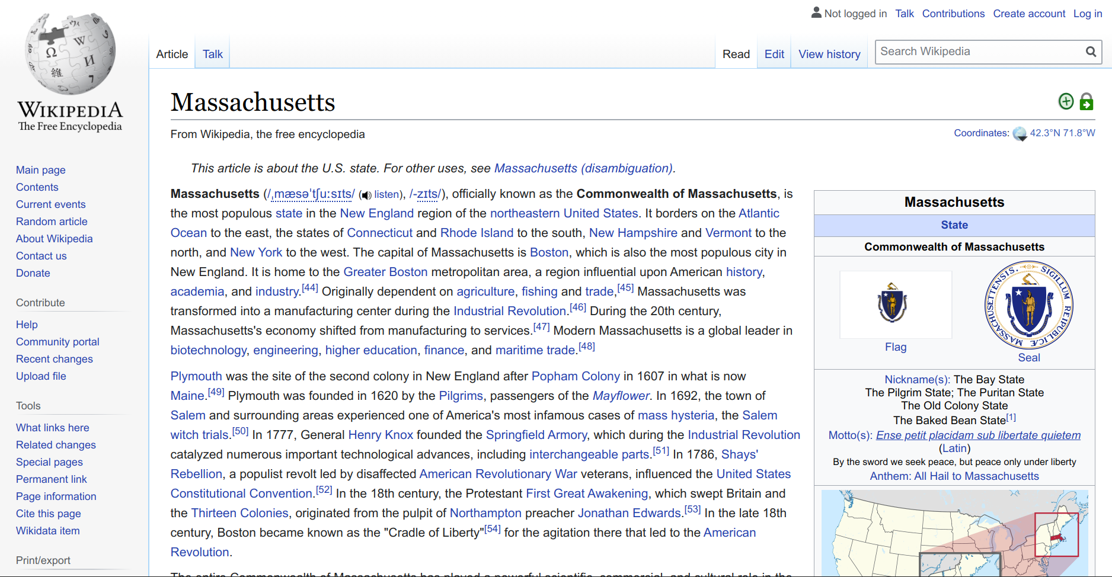
Generic Summarization vs Personalized Summarization
Generic Summary
= Specific Needs
Covers all topics well
Economy
Politics
Taxes
Education
Climate
Legislature
Location
Demography
But most covered
topics are
not relevant
Notes:
Existing text summarization tools mostly focus on generic summarization, but users often require personalized summarization that targets their specific preferences. For example, imagine a traveler who wants to summarize the Wikipedia page for the state of Massachusetts, but she is mostly interested in tourist spots and weather. A generic summary would cover all topics well, but not all topics are relevant to her.

Slide 6
Expressing Preferences Hard!
Notes:
But, precisely expressing summarization preferences is challenging.

Slide 7
Expressing Preferences Hard!
User preferences may span over multiple topics
Notes:
This is because the user’s preference may span over multiple topics and they don’t always know the precise coverages they want for each topic.

Slide 8
Personalized Summarization
Document
Personalized summary
Notes:
So, we need a system where the users can easily express their summarization preferences, without requiring to precisely specify topic coverages.

Slide 9
Summarization by Example
Notes:
In SuDocu, we propose a novel and effective way to express the summarization preferences through examples!

Slide 10
Summarization by Example
Example Summaries
Notes:
In example-driven summarization, all the user needs to do is to provide a few example summaries for a small number of documents,

Slide 11
Summarization by Example
Example Summaries
Automatic Summaries
Notes:
and the system learns the summarization intent from the examples. Then it can summarize new documents automatically, according to the user’s preferences.

Slide 12
Demo
Notes:
We will now demonstrate SuDocu and show how it learns the user’s summarization preferences just from a few examples.

Slide 13
SuDocu: Summarizing Documents by Example
Topic
Modeling
Example
Encoding
Intent
Discovery
Summary
Generation
Notes:
SuDocu is built over 4 key components which I will go over now.

Slide 14
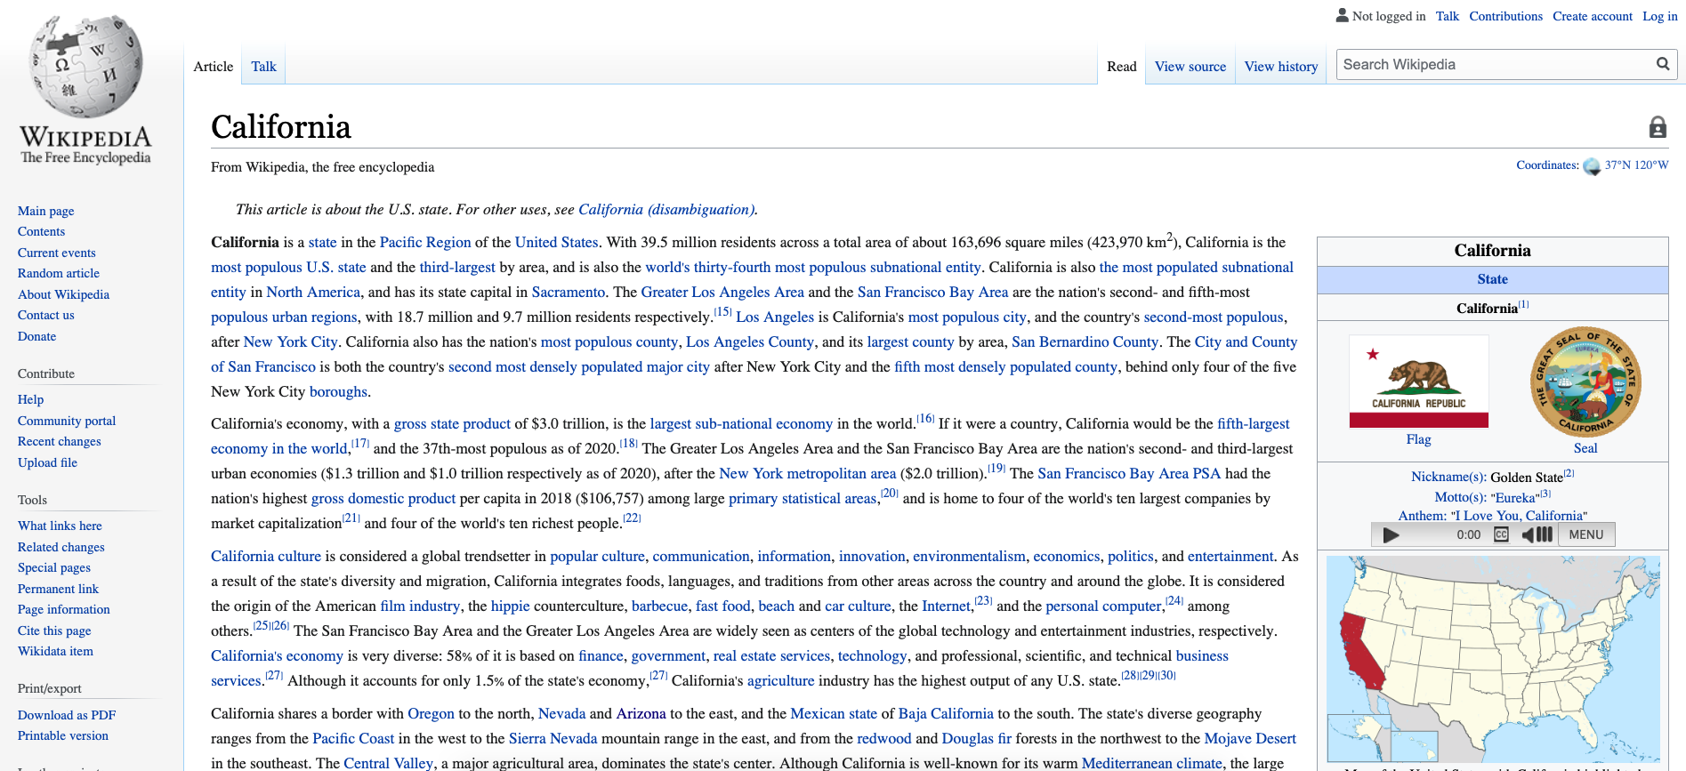
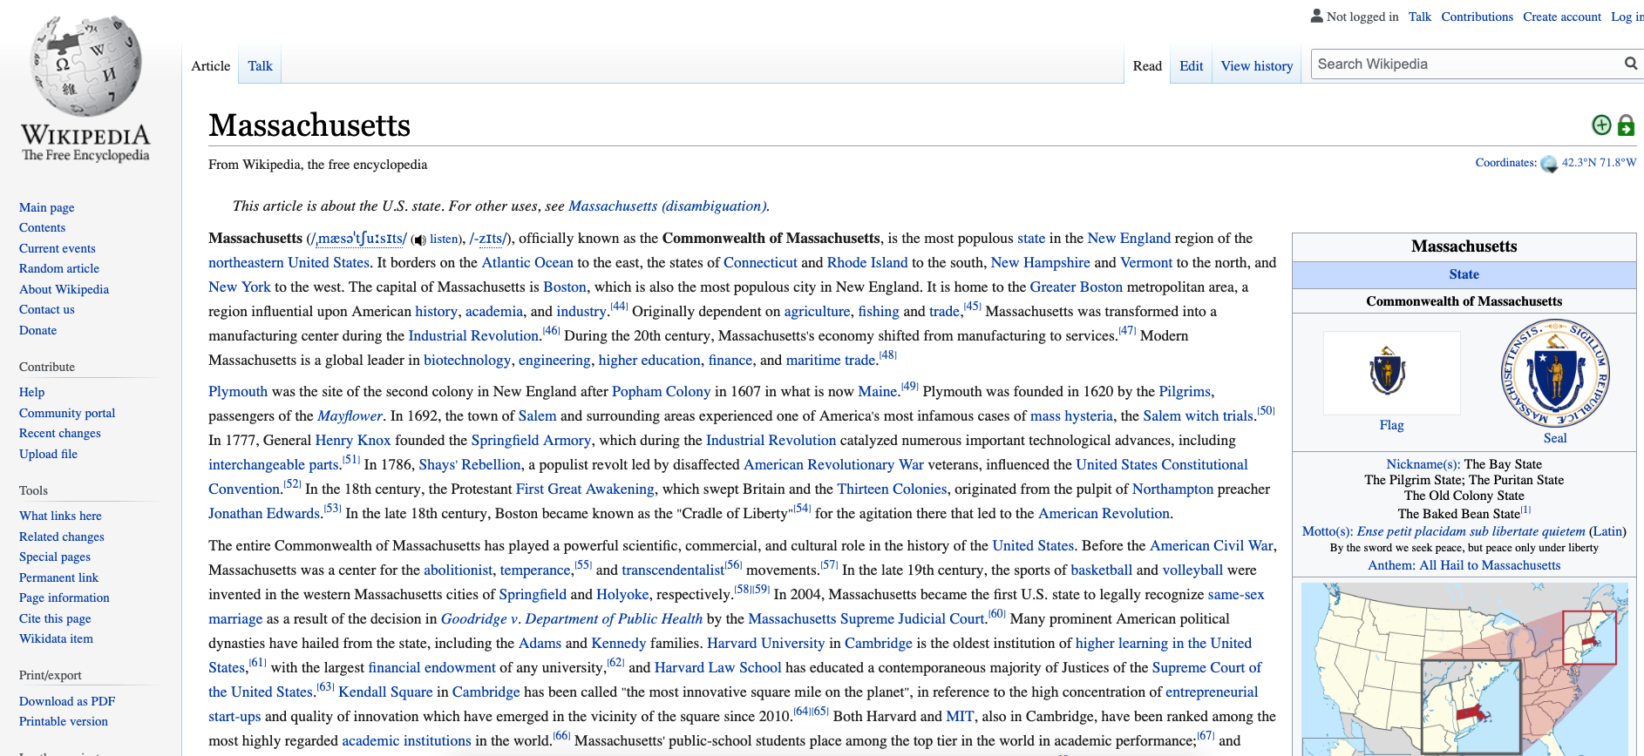
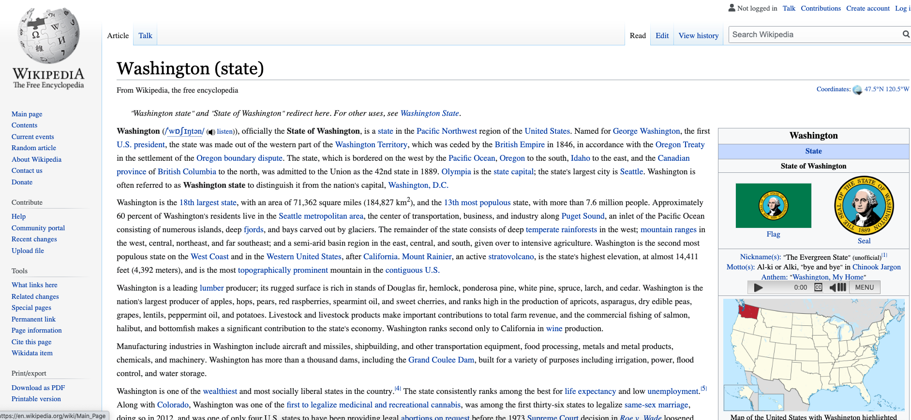
Topic Modeling
Text Corpus
Topics
Notes:
The first component is topic modeling. Given a text corpus over all documents, SuDocu uses LDA topic modeling to learn topics from the text corpus. Words that have similar semantic meaning and frequently occur together are grouped under the same topic.

Slide 15
Encoding Sentences using Topic Model
Each sentence is represented by a point in the topic space.
Notes:
SuDocu then uses the learned topic model to represent each sentence by a point in the topic space. So each sentence gets a score for every topic.

Slide 16
SuDocu: Summarizing Documents by Example
Topic
Modeling
Example
Encoding
Intent
Discovery
Summary
Generation
Notes:
The next step is to get example summaries from the user and encode them in the topic space as well.

Slide 17
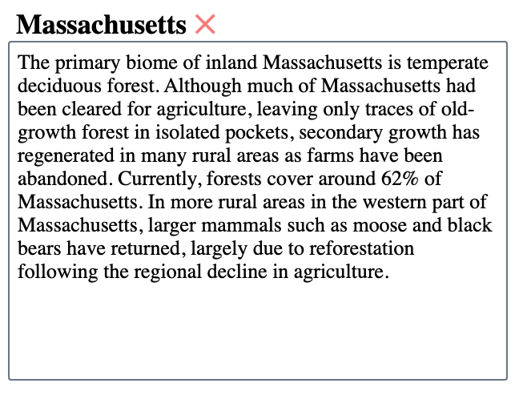
Encoding Example Summaries
An example summary is encoded by a vector in the topic space
by aggregating its topic-wise sentence scores.
Notes:
For this, SuDocu aggregates topic-wise scores over all sentences in the summary and encodes it in the topic space.

Slide 18
SuDocu: Summarizing Documents by Example
Topic
Modeling
Example
Encoding
Intent
Discovery
Summary
Generation
Notes:
The next step is to discover the user’s summarization intent.

Slide 19
Summarization Intent Discovery
Anna Fariha, Alexandra Meliou: Example-Driven Query Intent Discovery: Abductive Reasoning using Semantic Similarity. PVLDB 2019.
SuDocu computes topic-wise bounds from the example summaries to model intent.
These bounds specify the feasible space for new summaries.
Notes:
For this, SuDocu takes the topic-wise scores for each example summary and computes bounds. SuDocu interprets that the user wants their summaries to satisfy these bound constraints that define the space for feasible summaries.

Slide 20
Summarization Intent Discovery
Anna Fariha, Alexandra Meliou: Example-Driven Query Intent Discovery: Abductive Reasoning using Semantic Similarity. PVLDB 2019.
Feasible
Infeasible
SuDocu computes topic-wise bounds from the example summaries to model intent.
These bounds specify the feasible space for new summaries.
Notes:
If a summary satisfies the bounds for all topics, it is feasible, otherwise it is infeasible.

Slide 21
SuDocu: Summarizing Documents by Example
Topic
Modeling
Example
Encoding
Intent
Discovery
Summary
Generation
Notes:
The final step is to generate the summaries from the constraints.

Slide 22
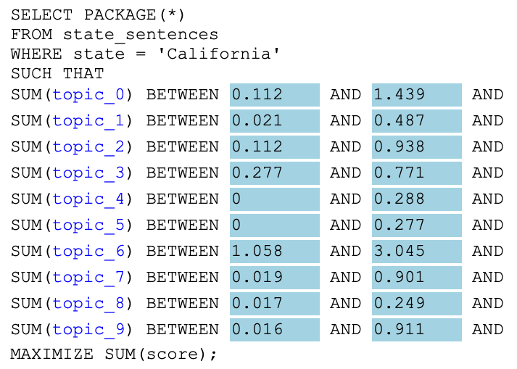
Synthesizing Package Query (PaQL)
SuDocu synthesizes a PaQL query from the summarization intent.
Notes:
SuDocu uses a package query to express the constraint optimization problem. The goal is to find a set of sentences that collectively satisfy the topic constraints, while maximizing some objective function. SuDocu’s objective is to maximize the overall quality of the summary, which we characterize by a generic score.

Slide 23
Summary Generation: Package Query
Matteo Brucato, Juan Felipe Beltran, Azza Abouzied, Alexandra Meliou: Scalable Package Queries in Relational Database Systems. PVLDB 2016.
Finally, SuDocu executes the PaQL query and generates the summary.
Notes:
Finally, for a new document, SuDocu executes the package query over a relational database using an efficient and scalable approach, retrieves the optimal summary, and then presents it to the user.

Slide 24
Takeaway
SuDocu is a personalized document summarization tool.
It learns user’s summarization intent from a few example summaries.
It uses topic modeling, semantic similarity discovery, and package queries for personalized document summarization.
SuDocu is highly scalable and efficient at generating new summaries.
Notes:
To summarize, SuDocu is a personalized document summarization tool which learns the user's summarization intent from a few example summaries. Performance-wise, SuDocu is highly-scalable and efficient.

Slide 25
Try SuDocu
sudocu.cs.umass.edu
Notes:
If you want to try SuDocu, please visit this site. Thank you for listening. We will be happy to answer questions.

