Slide 1
ExTuNe: Explaining Tuple Non-conformance
Anna Fariha, Ashish Tiwari, Arjun Radhakrishna, Sumit Gulwani
College of Information and Computer Sciences
University of Massachusetts Amherst
&
Microsoft
Notes:
Hi, I am Anna Fariha from University of Massachusetts Amherst.
I am going to demonstrate our work ExTuNe that explains tuple non-conformance.
This work was done while I was interning at Microsoft with Ashish Tiwari, Arjun Radhakrisha, and Sumit Gulwani.

Slide 2
Trusting Machine Learning Predictions
Training data
Notes:
First, let’s talk about the problem.
Suppose that you have trained your favorite machine learning model using these colorful apples to predict their color.

Slide 3
Trusting Machine Learning Predictions
Training data
New data
Red
Pink
Yellow
Orange
Green
Notes:
Now you deploy your model and your model seems to work pretty well for these new apples.
So far so good.

Slide 4
Trusting Machine Learning Predictions
Training data
New data
Red
Pink
Yellow
Orange
Green
Notes:
But now, you encounter this new thing, a strange watermelon wedge!
Now the question is, would you trust your model’s prediction on this?

Slide 5
Trusting Machine Learning Predictions
Training data
New data
Red
Pink
Yellow
Orange
Green
Green
Notes:
In data-driven machine learning, we sometimes encounter tuples, for which, the learned model is very much likely to make an incorrect prediction.
This usually happens when the tuple is significantly different from what the model has seen during training.

Slide 6
Non-conforming Tuple
Training data
New data
Red
Pink
Yellow
Orange
Non-conforming
Green
Green
Notes:
These are non-conforming tuples, that is, they don’t conform to the training data.

Slide 7
Can we always trust the predictions
made by a machine-learned model?
Notes:
A key application of detecting non-conformance is to figure out when we should trust predictions made by a machine learned model and when not.
This becomes an extremely critical issue when high-stake decisions are taken based on these predictions.
Wrong predictions made by machine learned models have caused serious issues in the past,

Slide 8
Machine Learning Fails
Notes:
such as unsafe medical treatment

Slide 9
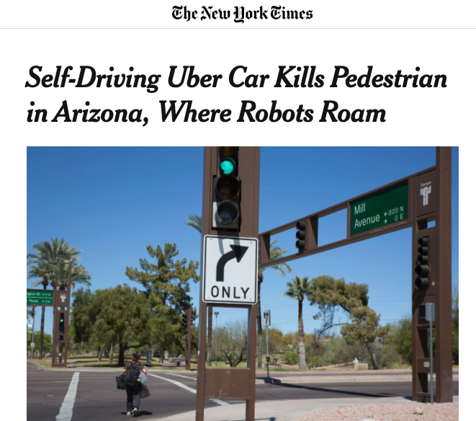
Machine Learning Fails
Notes:
and unsafe self-driving, which even caused human death!

Slide 10
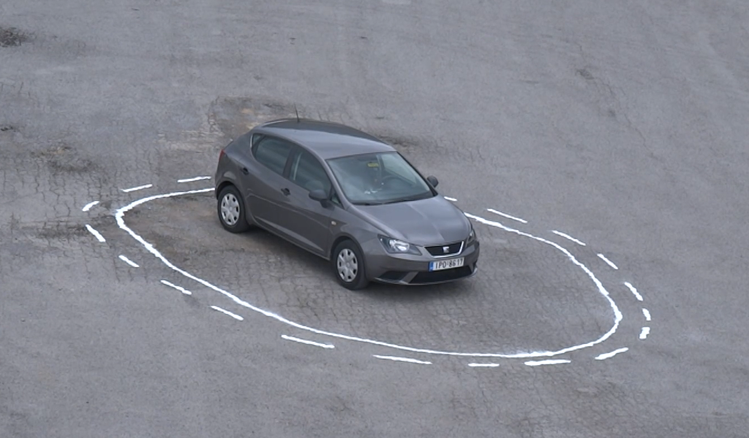
Non-conformance Causes Incorrect Prediction
Notes:
Many of these failures are due to non-conformance of the new data tuple with respect to the training data—something the model has never seen before.

Slide 11
Tuple Non-conformance
Detection
Is it
non-conforming?
Notes:
So the first question is, how can we detect tuple non-conformance?

Slide 12
Tuple Non-conformance
Detection
Explanation
Is it
non-conforming?
Why is it
non-conforming?
Notes:
And once we have detected a tuple as non-conforming, the next question is why? What is causing the non-conformance?

Slide 13
Tuple Non-conformance
Detection
Explanation
Is it
non-conforming?
Why is it
non-conforming?
Notes:
The focus of this demo is on the explanation, but before that, I am going to give a brief overview on the detection techniques on which ExTuNe is built.

Slide 14
Data Invariants
[Data Invariants: On Trust in Data-Driven Systems. arXiv pre-print, 2020]
constraints that the data satisfies
capture the invariants of the data
Detection
Notes:
To detect non-conformance, we use our previous work on data invariants.
Data invariants are a set of constraints that captures the common properties or “invariants” of the data.

Slide 15
Detecting Non-conformance
Violation of the data invariants
indicates non-conformance
Non-conforming tuples
Non-conforming tuples
Detection
Notes:
To detect non-conformance, we simply check whether a new tuple satisfies or violates the data invariants.
When a tuple violates the data invariants, then it is non-conforming.

Slide 16
Health Dataset Invariants
Height | Weight | BMI
6 feet | 142 lbs | 19.3
5 feet | 170 lbs | 33.2
5 feet | 130 lbs | 25.4
10 ≤ BMI ≤ 40
-40 ≤ (28 X Height— Weight) ≤ 30
Detection
Notes:
As an example, consider this health dataset with three attributes, height, weight, and BMI.
A simple data invariant on this dataset is that “BMI should be between 10 and 40”.
A slightly more complex data invariant is that “28 times height minus weight should be within the range -40 and 30”.
I will skip the details of data invariants and the techniques we use to compute good data invariants in this talk,
but at a high level, data invariants are constraints on linear combination of attributes.

Slide 17
Degree of Non-conformance
10 ≤ BMI ≤ 40
10 ≤ BMI ≤ 40
Height | Weight | BMI
6 feet | 142 lbs | 19.3
5 feet | 170 lbs | 33.2
5 feet | 130 lbs | 25.4
6 feet | 170 lbs | 231
Height | Weight | BMI
6 feet | 142 lbs | 19.3
5 feet | 170 lbs | 33.2
5 feet | 130 lbs | 25.4
Detection
Notes:
Now suppose that a new tuple arrives with BMI 231. This tuple is clearly non-conforming since it violates the data invariant that states the typical range of BMI.

Slide 18
Degree of Non-conformance
10 ≤ BMI ≤ 40
10 ≤ BMI ≤ 40
Height | Weight | BMI
6 feet | 142 lbs | 19.3
5 feet | 170 lbs | 33.2
5 feet | 130 lbs | 25.4
6 feet | 170 lbs | 231
6 feet | 170 lbs | 20000
Height | Weight | BMI
6 feet | 142 lbs | 19.3
5 feet | 170 lbs | 33.2
5 feet | 130 lbs | 25.4
Detection
Notes:
Now another tuple arrives with BMI 20,000. This tuple is way more non-conforming than the previous tuple.
To capture the degree of non-conformance, we measure how much it violated the data invariants. More violations means more non-conformance.

Slide 19
Tuple Non-conformance
Detection
Explanation
Is it
non-conforming?
Why is it
non-conforming?
Notes:
So far, I have talked about how we detect and measure the degree of tuple non-conformance. The goal of this demo is to provide an explanation so that we can understand the causes of these non-conformances.

Slide 20
ExTuNe Explaining Tuple Non-conformance
Ranking
Tuple-level explanation
Dataset-level explanation
Explanation
Notes:
Specifically, ExTuNe has three goals:
First, to rank and visualize the non-conforming tuples based on their degree of non-conformance.
Second, to provide tuple-level explanation for non-conformance. That is, given a non-conforming tuple, which of its attributes are responsible for its non-conformance.
And third, to do the same for the entire dataset, and not just one tuple; that is, show aggregated responsibility for each attribute across the whole dataset.
I will now give a high-level overview of the inner working of ExTuNe and then proceed to the demonstration.

Slide 21
Ranking Non-conforming Tuples
Sort by decreasing order of
invariant violation score
Explanation
Notes:
Ranking non-conforming tuples is straightforward. We compute invariant violation scores for all tuples and then sort them by decreasing order of the violation scores.

Slide 22
Tuple-level Explanation
Height | Weight | BMI
6 feet | 142 lbs | 19.3
5 feet | 170 lbs | 33.2
5 feet | 130 lbs | 25.4
6 feet | 170 lbs | 231
Explanation
Notes:
For tuple-level explanation, we want to figure out which attribute or interaction of attributes of a tuple are responsible for the non-conformance.
For example, is the abnormally high BMI causing this tuple’s non-conformance?

Slide 23
Tuple-level Explanation
Height | Weight | BMI
6 feet | 142 lbs | 19.3
5 feet | 170 lbs | 33.2
5 feet | 130 lbs | 25.4
6 feet | 170 lbs | 231
Explanation
Notes:
or is it an interaction between height and weight?

Slide 24
Intervention Reveals Causality
Height | Weight | BMI
6 feet | 142 lbs | 19.3
5 feet | 170 lbs | 33.2
5 feet | 130 lbs | 25.4
6 feet | 170 lbs | 25.9
Mean = 25.9
change
Explanation
Notes:
The key idea behind ExTuNe is to perform an intervention
that is, to change a value in the non-conforming tuple and set it to the attribute-mean over the dataset,
and then observe the causal effect—how it affects the tuple’s non-conformance.

Slide 25
Intervention Reveals Causality
Height | Weight | BMI
6 feet | 142 lbs | 19.3
5 feet | 170 lbs | 33.2
5 feet | 130 lbs | 25.4
6 feet | 170 lbs | 25.9
Blame!
Explanation
Notes:
If the intervention on an attribute makes the tuple no longer non-conforming, then we blame that attribute for causing its non-conformance.

Slide 26
Intervention Reveals Causality
Height | Weight | BMI
6 feet | 142 lbs | 19.3
5 feet | 170 lbs | 33.2
5 feet | 130 lbs | 25.4
16 feet | 70 lbs | 25.9
Blame!
Blame!
Explanation
Notes:
But in many cases, multiple attributes cause tuple non-conformance.
If intervening on any single attribute does not work, then we try intervening on different subsets of attributes until we can make the tuple conforming.
For example, in this case, both height and weight would get the blame and share equal responsibility for causing non-conformance, because this person is too tall with a very low weight.

Slide 27
ExTuNe Principles: Actual Causality
Actual Causality
If removing C
while K other events are also removed,
makes C counterfactual, then
C is an actual cause of E
C’s responsibility is 1/(K + 1)
Explanation
Notes:
ExTuNe’s principle is based on actual causality and responsibility. I will skip the details in this talk, but please refer to our paper for more details on this.
I will now proceed to demonstrate ExTuNe.

Slide 28
Notes:
Play it

Slide 29
Anomaly in COVID Dataset
Data Invariant: #positive + #negative = #total
178 + 120 = 298
178 + 120 ≠ 218
Notes:
Lastly, I want to show you an interesting discovery we made using ExTuNe.
We applied ExTuNe on the United State’s state-wise COVID patient statistics dataset. This was done during late march.
We learned invariants on data over a week and tried to find anomalies in the next week’s data.
During training, a very simple data invariant was learned: “the total number of tests should be equal to the sum of positive and negative cases”.
When we took a closer look at the non-conforming tuples, we found a data-entry error due to typo. The total number of tests for New Jersey should have been 298, where it was mistyped as 218. And ExTuNe correctly explained the cause of the error.

Slide 30
ExTuNe: Explaining Tuple Non-conformance
Alerts about non-conforming tuples
Explains causes of non-conformance
May locate data errors
Notes:
The final point I want to make is that identifying a tuple as non-conforming only means that we should be careful about predictions made on that tuple by any machine learned model, since the model never saw such patterns during training. It does not necessarily mean that the data is incorrect. But data error is one possible reason for tuple non-conformance, and ExTuNe can locate those errors.

Slide 31
Notes:
Thank you for listening. We will be happy to answer any questions over the communication channel.

