Slide 1


Conformance constraints discovery: measuring trust in data-driven systems
Anna Fariha*, Ashish Tiwari*, Arjun Radhakrishna, Sumit Gulwani, Alexandra Meliou
ACM SIGMOD/PODS International Conference on Management of Data
June, 2021

Slide 2
To trust or not to trust?
https://www.dailymail.co.uk/sciencetech/article-6001141/IBMs-Watson-suggested-inaccurate-unsafe-treatment-recommendations-cancer-patients.html

Slide 3


To trust or not to trust?
https://abc7news.com/technology/video-shows-deadly-crash-with-self-driving-uber-vehicle/3243857/
https://www.nytimes.com/2018/03/19/technology/uber-driverless-fatality.html

Slide 4
Conformance constraints: trusted ML

Slide 5
Trusting ML predictions
Training data
New data (after deployment)
Red
Pink
Yellow
Orange
Green

Slide 6

Trusting ML predictions
Training data
New data (after deployment)
Red
Pink
Yellow
Orange
Non-conforming
Green
Green

Slide 7
Non-conformance
= untrustworthy prediction
Detection
Is it
non-conforming?

Slide 8
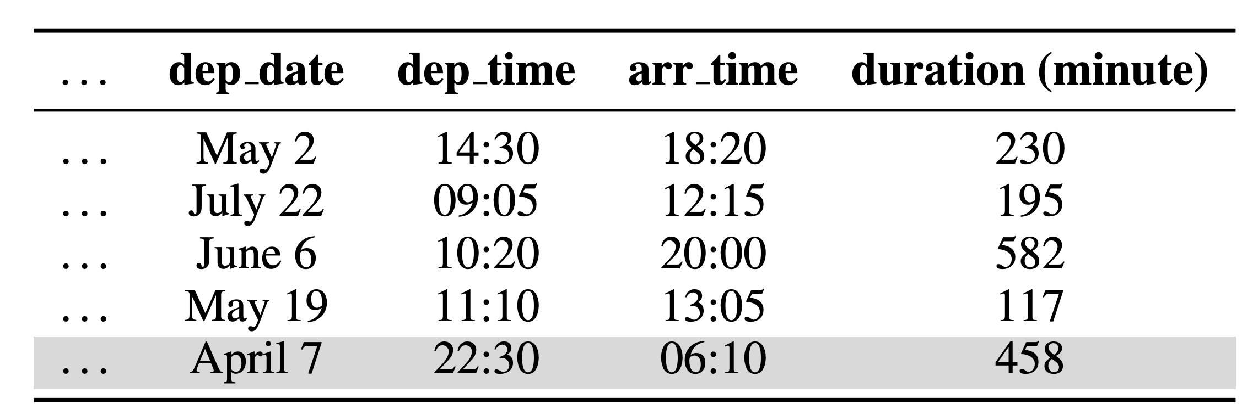
A real-world example: airlines dataset
Prediction task: predict arrival delay (regression)
DAYTIME
flights
OVERNIGHT flight

Slide 9
A real-world example: airlines dataset
Trained over DAYTIME flights
Constraints
  “departure time is earlier than arrival time”
  “their difference is very close to flight duration”
OVERNIGHT flights
  violate DAYTIME flights’ constraints
  incur high prediction error
Constraint violation correlates with prediction error

Slide 10
Conformance constraints (CCs)
  constraints that the data satisfies
  capture the invariants of the data

Slide 11
Conformance constraints
Encode linear arithmetic relationship over multiple attributes
-𝝐 $≤$(60 . arr_hour + arr_min) – (60 . dep_hour + dep_min) – duration $≤$𝝐
Projection
Arrival Time – Departure Time – Duration
Lower bound
Upper bound

Slide 12
Conformance constraints: example
Height | Weight | BMI
6 feet | 142 lbs | 19.3
5 feet | 170 lbs | 33.2
5 feet | 130 lbs | 25.4
  10 ≤ BMI ≤ 40
  -40 ≤ (28 X Height— Weight) ≤ 30

Slide 13
Violation of conformance constraint
  10 ≤ BMI ≤ 40
  10 ≤ BMI ≤ 40
Height | Weight | BMI
6 feet | 142 lbs | 19.3
5 feet | 170 lbs | 33.2
5 feet | 130 lbs | 25.4
6 feet | 170 lbs | 231

Slide 14
Projection
-𝝐 $≤$(60 . arr_hour + arr_min) – (60 . dep_hour + dep_min) – duration $≤$𝝐
Projection
Lower bound
Upper bound

Slide 15
How to find good projections?
  ML pipelines drop low-variance dimensions to achieve dimensionality reduction.
  ML models assume that training data’s constraints/properties will continue to hold during serving.

Slide 16



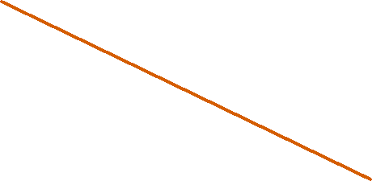

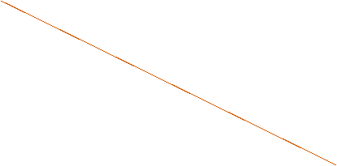

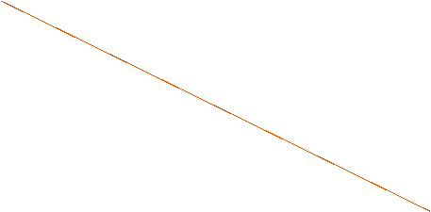
Low-variance projections
High variance
F2
Low variance
F3
F1
High variance

Slide 17
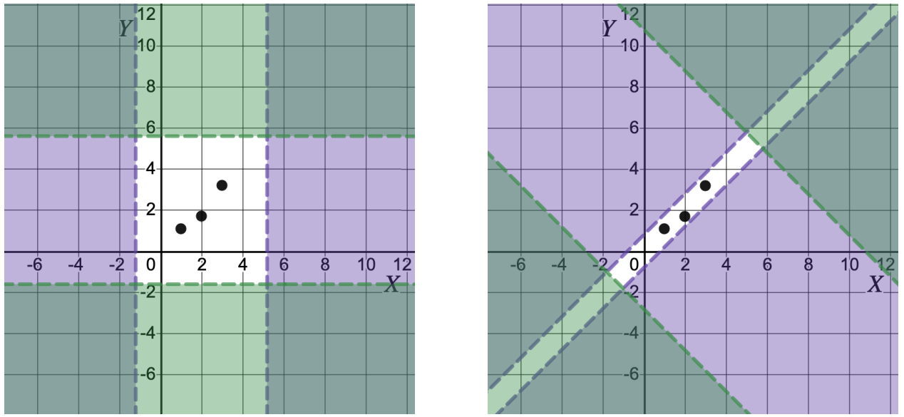


Projections with small mutual correlation

Slide 18
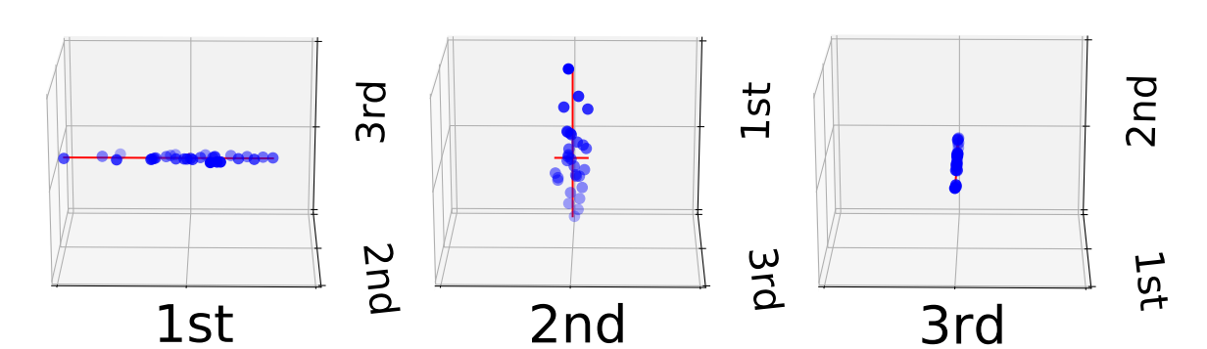
Discovering projections:
Principal Component Analysis (PCA)
Small mutual correlations
  Why? PCA generates orthogonal projections
Low-variance
  Weigh low variance more
  Weigh high variance less
weight

Slide 19
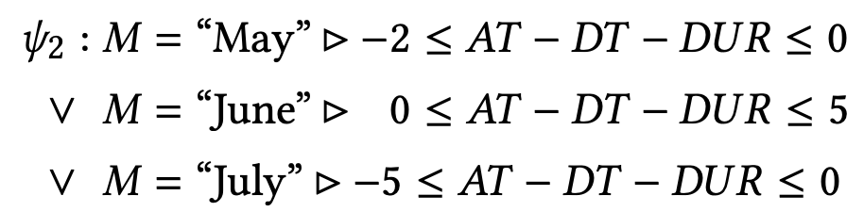
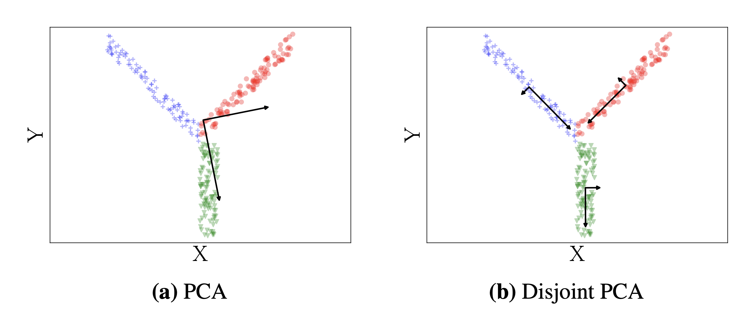
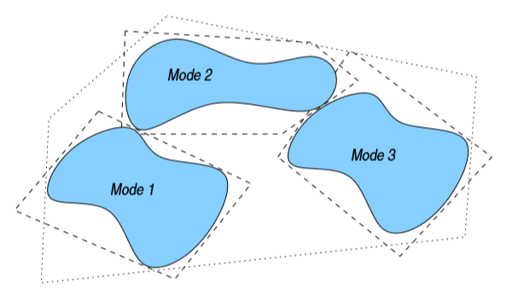
Disjunctive conformance constraints
Disjoint partitions
Learn CCs for each partition
Compute disjunctive CCs

Slide 20
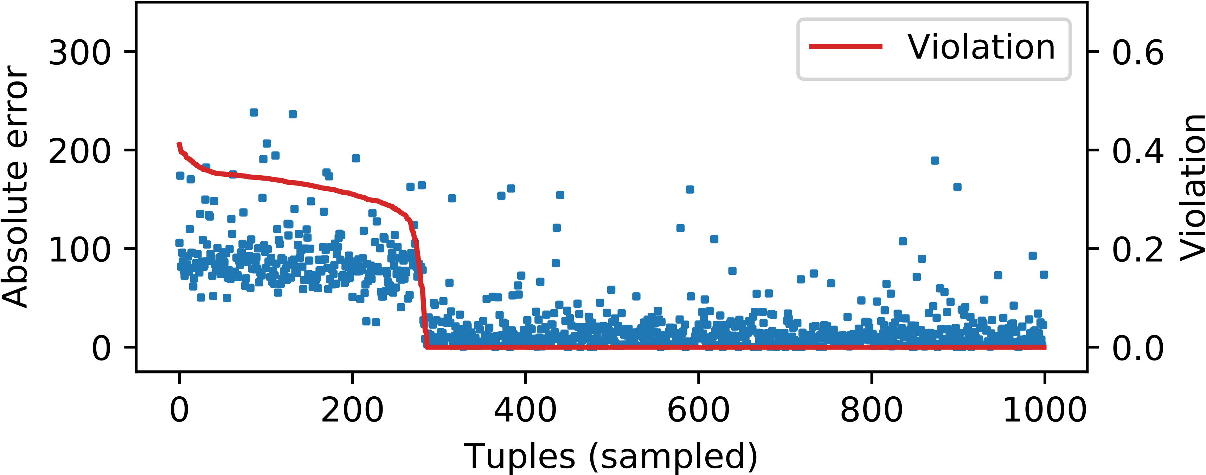
Evaluation: trusted machine learning
Is there a relationship between CC violation and the ML model’s prediction error?

Slide 21
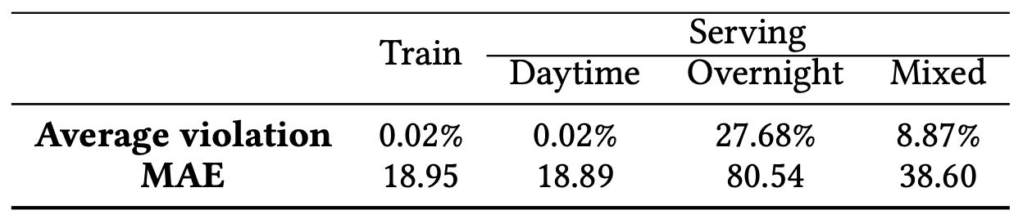
Evaluation: trusted ML
Constraint violation correlates with prediction error

Slide 22
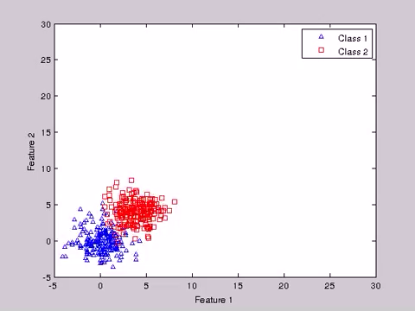
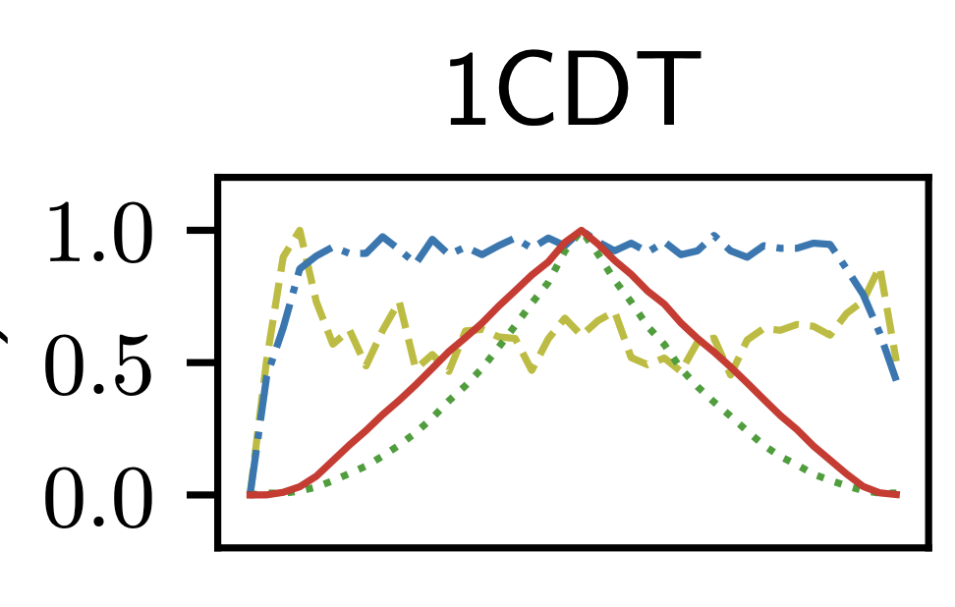
Evaluation: data drift over synthetic
Benchmark (EVL)
Drift
Time

Slide 23
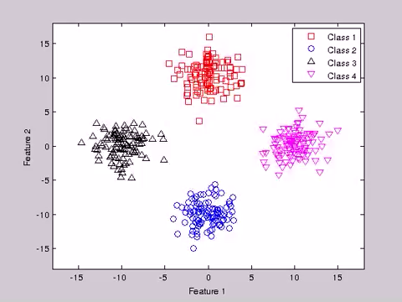
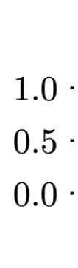
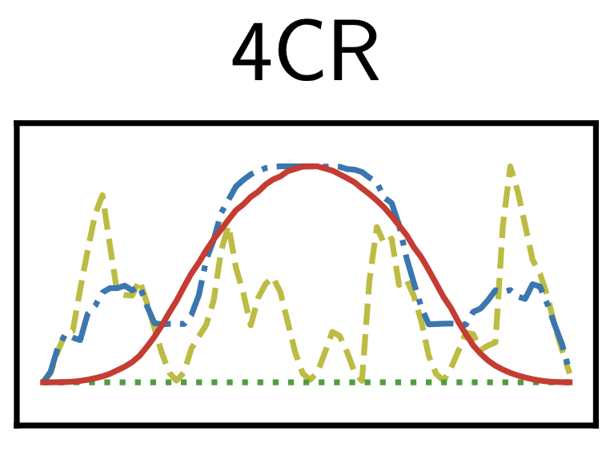
Data drift: EVL benchmark (2/3)
Drift
Time

Slide 24
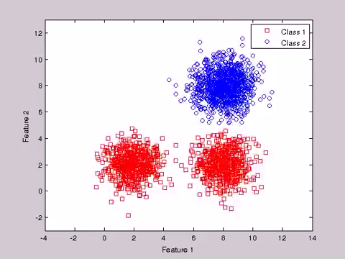
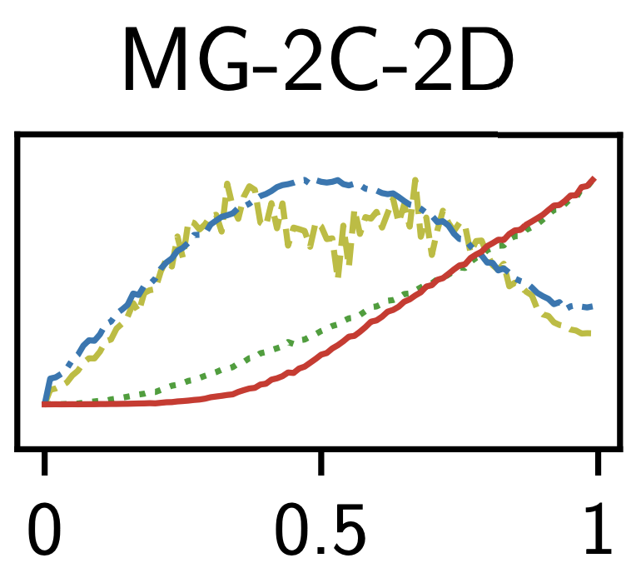
Data drift: EVL benchmark (3/3)
Drift
Time

Slide 25
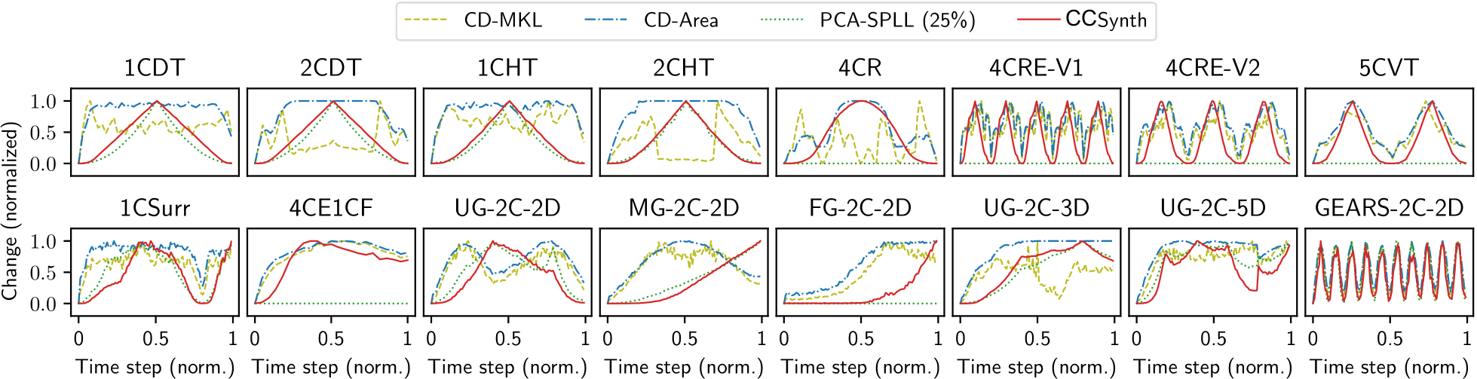
Evaluation: data drift

Slide 26
Key takeaways
Conformance constraint is a new data profiling primitive to model linear arithmetic relationships among numerical data attributes.
Conformance constraints help in trusted machine learning and data-drift quantification.
Anna Fariha <afariha@cs.umass.edu>

