Slide 1


Causality-Guided
Adaptive Interventional Debugging
Anna Fariha
Suman Nath
Alexandra Meliou
College of Information and Computer Sciences
University of Massachusetts Amherst
&
Microsoft Research, Redmond
Notes:
Hi, I am Anna Fariha from University of Massachusetts, Amherst.
This is a joint work with Suman Nath from Microsoft Research and my advisor Alexandra Meliou.
Today, I am going to talk about a data-driven debugging technique that explains why data systems fail intermittently.

Slide 2
DBMS are complex and contain bugs
concurrent
parallel
asynchronous
Notes:
Data management systems and database-backed applications heavily rely on asynchronous and concurrent processing.
Like other complex systems, these systems also have bugs. Bugs cause serious issues like data corruption, unresponsiveness, and crash.

Slide 3
Intermittent failure
sometimes succeeds sometimes fails
Runtime conditions
Thread scheduling
Timing
{
name = "SIGMOD",
venue = "Portland",
year = 2020
}
DBMS
Input
Notes:
A notorious kind of bugs are those that manifest only intermittently.
Even for the same input, an intermittently failing application sometime succeeds, and sometime fails.
The success or failure depends not only on the input, but also on the randomness in the runtime conditions such as thread scheduling and timing.

Slide 4
Motivation and goal
Can’t reproduce!
Help me debug!
Investigate root causes of intermittent failure
Notes:
And that’s why intermittent bugs are hard to reproduce and very hard debug.
Our goal is to investigate the root causes of these hard-to-catch intermittent failures.

Slide 5
Example system: Npgsql
[ADO.NET data provider for PostgreSQL]
pools
50 | 700 | 56 | 47
0 | 1 | 2 | 3 | 4
last_slot
3
localPools
50 | 700 | 56 | 47
0 | 1 | 2 | 3 | 4
Thread 1
Thread 2
Find(key):
localPools = pools
for i in range(0,last_slot+1): if localPools[i] == key:
return i
return null
Notes:
I will now give an example of intermittent failure in Npgsql.
It's an A D O dot NET data provider for postgres.
So in Npgsql's database connection manager module, two threads share a global array called pools.
Pools keeps track of the active database connections.
The variable last slot is also shared. and it stores last used index of the pools array.
The Find function runs in thread 1. Given a connection key, Find returns its index within the pools array.
For example, for key 56, Get returns 2.
If a key is not found, Find returns null.
For searching a key, Find first copies the shared array into a local array. Then it searches in the local array until it finds the key or reaches the last_slot index.

Slide 6
Example system: Npgsql
[ADO.NET data provider for PostgreSQL]
pools
50 | 700 | 56 | 47
73
0 | 1 | 2 | 3 | 4
last_slot
3
localPools
50 | 700 | 56 | 47
0 | 1 | 2 | 3 | 4
Thread 1
Thread 2
Find(key):
localPools = pools
for i in range(0,last_slot+1): if localPools[i] == key:
return i
return null
Add(key):
if pools_is_filled:
pools = ResizeDouble(pools)
last_slot ++
pools[last_slot] = key
Notes:
The Add function is in thread 2. Given a new key, the add function inserts the key to the pools array.

Slide 7
Example system: Npgsql
[ADO.NET data provider for PostgreSQL]
pools
50 | 700 | 56 | 47
73
0 | 1 | 2 | 3 | 4
last_slot
3
localPools
50 | 700 | 56 | 47
0 | 1 | 2 | 3 | 4
Thread 1
Thread 2
Find(key):
localPools = pools
for i in range(0,last_slot+1): if localPools[i] == key:
return i
return null
Add(key):
if pools_is_filled:
pools = ResizeDouble(pools)
last_slot ++
pools[last_slot] = key
Notes:
For inserting the key, Add first checks if the pools array is already at capacity. If there is no more room in the pools array for the new key, Add doubles the pool size.

Slide 8
Example system: Npgsql
[ADO.NET data provider for PostgreSQL]
pools
50 | 700 | 56 | 47
73
0 | 1 | 2 | 3 | 4
last_slot
4
localPools
50 | 700 | 56 | 47
0 | 1 | 2 | 3 | 4
Thread 1
Thread 2
Find(key):
localPools = pools
for i in range(0,last_slot+1): if localPools[i] == key:
return i
return null
Add(key):
if pools_is_filled:
pools = ResizeDouble(pools)
last_slot ++
pools[last_slot] = key
Notes:
It then increases last_slot by one

Slide 9
Example system: Npgsql
[ADO.NET data provider for PostgreSQL]
pools
50 | 700 | 56 | 47
73
0 | 1 | 2 | 3 | 4
last_slot
4
localPools
50 | 700 | 56 | 47
0 | 1 | 2 | 3 | 4
Thread 1
Thread 2
Find(key):
localPools = pools
for i in range(0,last_slot+1): if localPools[i] == key:
return i
return null
Add(key):
if pools_is_filled:
pools = ResizeDouble(pools)
last_slot ++
pools[last_slot] = key
Notes:
and stores the new key there.

Slide 10
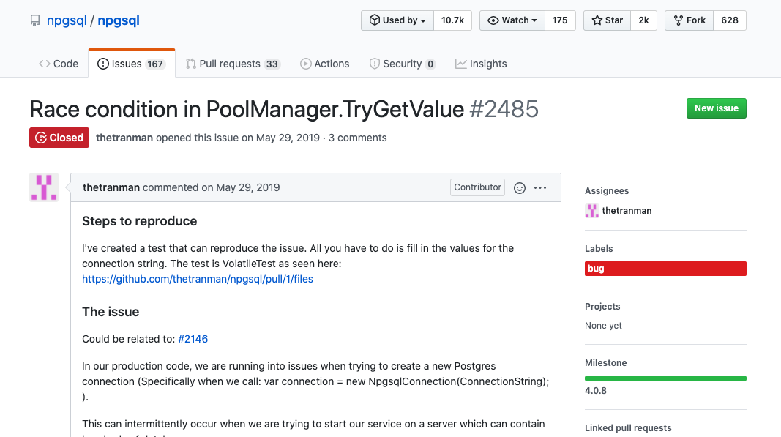
Npgsql intermittent failure
Notes:
So let's talk about an intermittent bug in Npgsql.
This was reported last year during May.

Slide 11
Npgsql intermittent failure
pools
50 | 700 | 56 | 47 | 73
0 | 1 | 2 | 3 | 4
last_slot
4
localPools
50 | 700 | 56 | 47 | 73
0 | 1 | 2 | 3 | 4
Thread 1
Thread 2
Find(key):
Add(key):
1
localPools = pools
Notes:
This is how the bug happens:
So, Find wants to find index of a key.
For that, it first copies pools to local memory,

Slide 12
Npgsql intermittent failure
pools
50 | 700 | 56 | 47 | 73
89
0 | 1 | 2 | 3 | 4
5 | 6 | 7 | 8 | 9
last_slot
5
Array Index Out of Bound
localPools
50 | 700 | 56 | 47 | 73
0 | 1 | 2 | 3 | 4
5
Thread 1
Thread 2
Find(key):
Add(key):
if pools_is_filled:
pools = ResizeDouble(pools)
last_slot ++
pools[last_slot] = key
1
localPools = pools
for i in range(0,last_slot+1): if (localPools[i] == key)
return i
return null
2
3
Notes:
Right after that, the Add function, in another thread, adds a new key to pools which requires resizing pools.
So now, last_slot indicates index 5.
Now when Find gets back to work, it starts searching localPools.
Since last slot is now 5, it will hit index 5 in the localPools. But localpools has no such index.
So it will throw an index out of bound exception and the program will crash.

Slide 13
Npgsql intermittent failure
1
localPools = pools
if pools_is_filled:
pools = ResizeDouble(pools)
last_slot ++
pools[last_slot] = key
2
for i in range(0,last_slot+1): if (localPools[i] == key)
return i
return null
3
Notes:
This issue arises only when this specific interleaving happens in the two threads.

Slide 14
Investigating Npgsql crash
Add() temporally overlaps with Find()
Root cause
Find()attempts to access invalid array index
Predicates
Explanation
Explanation
Find()throws ArrayIndexOutOfBound exception
Failure
Notes:
Specifically, at first, Add() temporally overlaps with Find().
Which causes Find to make an attempt to access an invalid array index.
This causes an array index out of bound exception,
And it finally crashes the program.
All of these events cause this failure.
Now we want identify two things:
number one, the root-cause of the failure.
And number two, an explanation that tells us how the root cause triggers the failure.
In this work, we call all these runtime events Predicates.

Slide 15
Root-cause analysis of intermittent bugs
Static/dynamic program analysis
statistical debugging
correlation ≠ causation
heavy-weight
data-driven
correlation-based
Notes:
There are many techniques for root cause analysis such as static and dynamic program analysis, but those are heavy-weight techniques.
We wanted to solve the problem in a data-driven manner, because it's light-weight and generalizes to any platform.
Statistical debugging is an existing data-driven technique that partially addresses our problem. It reports predicates that are highly correlated with failure as potential root-causes.
But statistical debugging is based on just correlation and we all know that correlation does not imply causation.

Slide 16
Limitations of statistical debugging
Find() is running too slow
Find() and Get() temporally overlaps
Get() is running too fast
…
crash
Notes:
Specifically, there are two main limitations of statistical debugging.
First, it produces a long list of correlated predicates, and ultimately relies on the developer to investigate this long list of predicates manually.
And second, it does not explain how a root cause triggers the failure.
So in this work, we have two goals:

Slide 17
Our goals
Root-cause identification
Find() and Get() temporally overlaps
crash
Notes:
First, to pin-point and isolate the true root-cause of the intermittent failure.

Slide 18
Our goals
Root-cause identification
Find() and Get() temporally overlaps
array access
at invalid index
Explanation
index-out-of-bound exception
crash
Notes:
and
second, to connect the dots from the root cause to the failure with a set of causally connected intermediate predicates.
This chain of predicates explains how the root cause triggers the failure more precisely.

Slide 19





AID recipe
statistical
debugging
fault
injection
group
testing
causality
Notes:
Now I am going to talk about how we achieve these two goals.
Our approach AID is built on 4 existing techniques

Slide 20

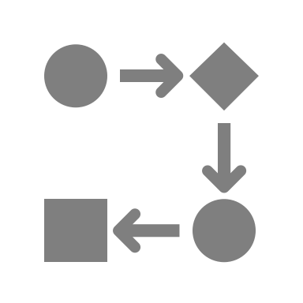


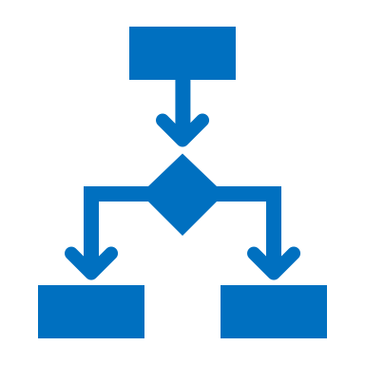
AID
causality
statistical
debugging
fault
injection
group
testing
Notes:
And combines them in a novel way to achieve our goals.
Given an application that fails intermittently,
AID first uses statistical debugging to find a list of candidate predicates.
AID then uses causality principles to makes an initial guess about the causal relationships of these candidate predicates.
AID then verifies causality by actually tweaking the predicates. For tweaking predicates, AID injects faults to the source code.
To expedite root-cause analysis, instead of tweaking one predicate at a time, AID uses group testing and tweaks multiple predicates simultaneously.
Based on outcomes of one round, AID plans for the next round. AID repeats these steps until it pin points the root cause and explanation of the failure.

Slide 21
Finding candidate predicates
Step 1: Program instrumentation finds all predicates
Step 2: Statistical debugging finds correlated predicates
Always appear in
failed executions
Never appear in
successful executions
foo()
foo()
bar()
bar()
Notes:
So let’s talk finding the candidate predicates.
We first instrument the source code to generate execution logs when the program executes, and from the execution logs, we extract predicates.
Then we use statistical debugging to find predicates that are highly correlated with failure but rarely observed in successful executions.
AID uses these predicates as candidates.

Slide 22

AID
causality
statistical
debugging
fault
injection
group
testing
Notes:
AID's next step is to find out, within the candidate predicates, what is causing what.
The candidate predicate set can be very large and checking all pair causal relationships is too expensive.
So AID first approximates their causal relationships.

Slide 23
Temporal precedence graph
Cause must temporally precede effect
P1
P2
P3
P4
P7
P5
P8
P11
P6
P9
P10
F
Notes:
Since a cause must temporally precede an effect, we can use temporal precedence graph of the predicates to approximate their cause-effect relationships. Since a program cannot go back in time, this graph will always be directed and acyclic.

Slide 24
Approximating causality
P1
P2
P1 may cause P8
P3
P4
P7
P5
P8
P11
P6
P9
P10
F
Notes:
For example, in this temporal precedence graph, there is a path from P1 to P8. And this implies that P1 may cause P8.

Slide 25
Approximating causality
P1
P2
P3
P4
P7
P5
P8
P11
P6
P9
P4 cannot cause P9
P10
F
Notes:
On the other hand, there is no path from P4 to P9, so P4 cannot cause P9.

Slide 26
Counterfactual causality
C is a counterfactual cause of E
If C had not occurred
E would not have occurred
Notes:
Temporal precedence is necessary for causation, but it is not sufficient.
There exists many different notions of causality in the literature,
But in this paper, we adapt counterfactual causality.
Counterfactual causality says that if stopping an event C, stops another event E, then C is a counterfactual cause of E.
So how can we verify counterfactual causality?

Slide 27
Intervention
Notes:
To verify counterfactual causality, we apply interventions.
Intervening on a predicate alters its behavior during run time, so that it behaves exactly like the successful executions.
The key idea is to check if intervening on a predicate, always stops the failure. If it does, according to counterfactual causality, it is a true cause of the failure.

Slide 28
AID
causality
statistical
debugging
fault
injection
group
testing
Notes:
So how can we implement these runtime interventions?
AID uses an existing technique that injects faults to a program to make it behave in a certain way.

Slide 29
Fault injection
Find()
Add()
Notes:
For example, to prevent temporal overlap between Find and add, AID injects locks around both Find and Add to ensure their mutual exclusion during runtime.

Slide 30
AID
causality
statistical
debugging
fault
injection
group
testing
Notes:
If we intervene on one predicate at a time, it will require a large number of iterations, since each intervention requires going through all these steps, which is quite expensive.
To reduce the number of interventions, AID uses group testing.

Slide 31
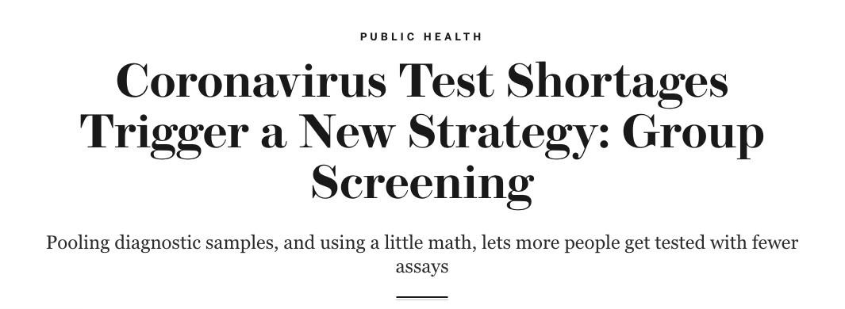
Group testing
Notes:
So what do you do when there are not enough test kits for, say, COVID testing?
Well, when testing on each individual is not feasible, group testing is an alternative and cheaper option!

Slide 32
Adaptive group testing
Notes:
In group testing, instead of testing each individuals, we test on groups.
For example, we can mix blood samples of a group of people, and then test that mixture.
AID uses adaptive group testing. In adaptive group testing, when result of an entire group is negative, we can declare that all of them have tested negative.
Otherwise, we keep splitting the group until we reach certain conclusions.
So what to test next is adaptively decided depending on the results of previous tests. And this reduces the number of tests required.

Slide 33
AID applies group intervention
P1
P2
P3
P4
P7
P5
P8
P11
P6
P9
P10
F
Notes:
Following this idea of adaptive group testing, AID applies adaptive group intervention on predicates to reduce the number of intervention rounds.

Slide 34

AID
causality
statistical
debugging
fault
injection
group
testing
Notes:
In traditional group testing, intervention on a group only gives information about that group, but tells nothing about other groups. But our setting is slightly different and we have a temporal precedence graph as an extra piece of information. AID exploits this to further prune predicates beyond traditional group testing.

Slide 35
AID pruning
P1
P2
P3
P11
P10
F
Notes:
Trivially, if a predicate is disabled, by intervention, but the program still fails, that predicate cannot be the root-cause. So AID eliminates that predicate just like adaptive group testing.
Further, if intervening on a predicate disables some other predicate that appear temporally later, but the failure is still there.
This means that the other predicate is being caused by the predicate under intervention, and has nothing to do with the actual failure.
So AID prunes these predicates as well. But Classical group testing cannot do this kind of pruning.

Slide 36
Notes:
I am done talking about the the technical details of AID and I will now proceed to present our evaluation results.

Slide 37

Six real-world bugs
Data race
Use-after-free
Timing-bug
Network
BuildAndTest
HealthTelemetry
Random number collision
Order violation
Race condition
Notes:
We evaluated AID on 6 real world intermittently failing applications with different root causes. For all of them AID successfully found the true root causes and the correct explanation chain.

Slide 38
Statistical debugging vs AID
AID produces no false positives
Notes:
Here you can see that the number of predicates reported by statistical debugging is much more than the number of predicates in the actual causal chain. This is because statistical debugging reports many false positives. But AID always found the predicates in the actual causal path correctly.

Slide 39
Adaptive group testing vs AID
AID’s pruning reduces #Interventions
Notes:
This chart shows the number of required interventions in adaptive group testing vs AID. AID’s predicate pruning significantly reduced the number of interventions compared to adaptive group testing.

Slide 40
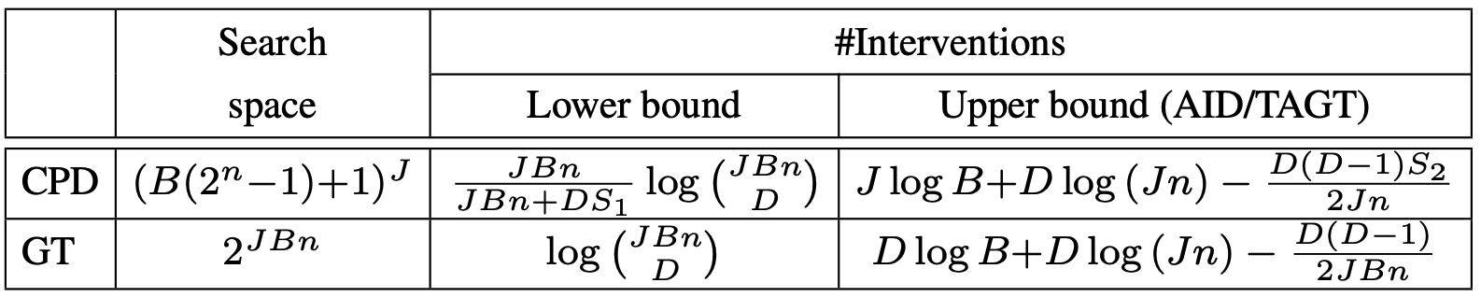
Theoretical analyses
CPD: Causal Path Discovery
GT: Group Testing
AID: Adaptive Interventional Debugging
TAGT: Traditional Adaptive Group Testing
Notes:
Apart from the great empirical findings, we also theoretically establish that
AID’s problem setting allows smaller search space and AID requires much fewer interventions that traditional adaptive group testing and a lower information theoretic lower bound.
Please refer to our paper for more details on this.

Slide 41
Takeaway
AID is a data-driven technique for debugging intermittent failures.
AID produces causally verified root cause and explanation.
AID is more accurate than statistical debugging.
AID is more efficient than adaptive group testing.
Notes:
To summarize,
AID is a data-driven technique for debugging intermittent failures.
It produces causally verified root cause and explanation chains of intermittent failures.
AID is more accurate than statistical debugging and more efficient than adaptive group testing.
Thank you for listening. We will be happy to answer questions through the communication channel.

