Slide 1
Large Language Models for
Data Management Tasks
Anna Fariha
University of Utah
Northwest Database Society (NWDS) Annual Meeting 2024

Slide 2
Questions to think about …
Can LLMs do cardinality estimation and query optimization?
Can LLMs help with homogenizing data formats?
Can LLMs help in database index tuning?
Notes:
Can I see a raise of hands

Slide 3
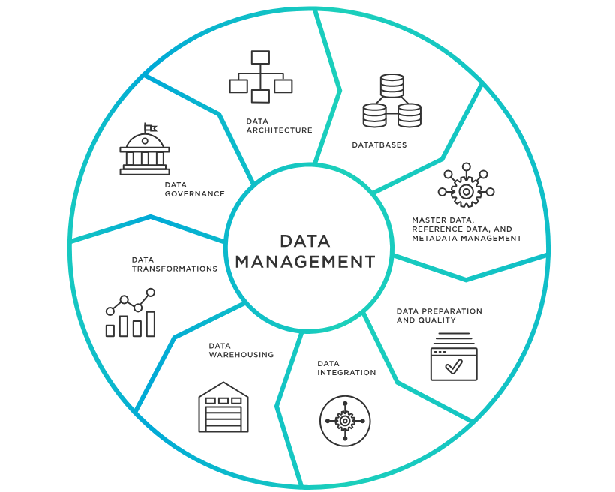
Which data-management tasks are well suited for LLM?
Should I use ChatGPT for cleaning up the addresses?
Notes:
Data-management tasks have a varied properties and goals, ranging from data storing, retrieving, indexing, and cleaning… to analytics, and visualization.
In today’s era of generative AI and large language models, a super common approach to deal with ANY task or problem is to try out LLM. We ask, “Have you tried ChatGPT for this task?”
While LLMs can potentially assist in many of the data management tasks, they aren’t equally suitable, or natural fit, for all the tasks. It depends on the task, and more specifically, certain properties of a task.

Slide 4
What factors of a task determines LLM’s suitability for it?
1
Data Context
Schema
Data distribution
Data format
2
System Context
Query workload
Database configuration
Hardware
3
Domain Expertise
What denotes missing value?
What are valid values?
What outliers are expected?
4
Code Requirement
Is the mechanism required?
Destructive side effect (deletion)
5
Uncertainty
Objectiveness of the task
Risk-level of the task
User trust
Notes:
Can we create a taxonomy of DM tasks based on certain properties and map those properties to LLM-suitability

Slide 5
Interviews over 14 data scientists [Chopra et al. 2023]

Slide 6
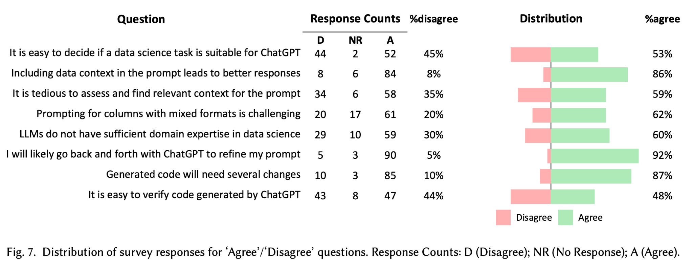
Results of survey over 114 data scientists [Chopra et al. 2023]

Slide 7
Whether to ask for the mechanism or the result?
More control
Less control
Difficult to verify
Easy to verify
Reusable
Not reusable

Slide 8
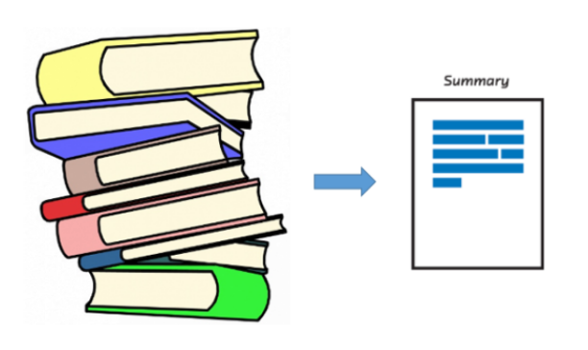
Identify low-hanging fruits!
Data cleaning
Data summarization
Data organization and categorization

Slide 9
Thank you
Bhavya Chopra, Ananya Singha, Anna Fariha, Sumit Gulwani, Chris Parnin, Ashish Tiwari, Austin Z. Henley. Conversational Challenges in AI-Powered Data Science: Obstacles, Needs, and Design Opportunities. CoRR abs/2310.16164 (2023)
Andrew M Mcnutt, Chenglong Wang, Robert A Deline, and Steven M. Drucker. 2023. On the Design of AI-Powered Code Assistants for Notebooks. CHI ’23.
Noah Hollmann, Samuel Müller, and Frank Hutter. 2023. LLMs for Semi-Automated Data Science: Introducing CAAFE for Context-Aware Automated Feature Engineering. arXiv:2305.03403
Jean Kaddour, Joshua Harris, Maximilian Mozes, Herbie Bradley, Roberta Raileanu, and Robert McHardy. 2023. Challenges and Applications of Large Language Models
Priyan Vaithilingam, Tianyi Zhang, and Elena L. Glassman. 2022. Expectation vs. Experience: Evaluating the Usability of Code Generation Tools Powered by Large Language Models. In Extended Abstracts 2022 CHI.

