Slide 1
Through the Data Management Lens: Experimental Analysis and Evaluation of Fair Classification
Maliha T Islam¹ Anna Fariha² Alexandra Meliou¹ Babak Salimi³
¹University of Massachusetts Amherst ²Microsoft ³University of California, San Diego
Notes:
Hi everyone, I’m Anna Fariha from Microsoft.
Today I’ll talk about our work on an experimental analysis of several fair classification methods, but from a data management perspective.
This is a joint work with Maliha Islam and Alexandra Meliou from UMass Amherst, and Babak Salimi from UC San Diego.

Slide 2
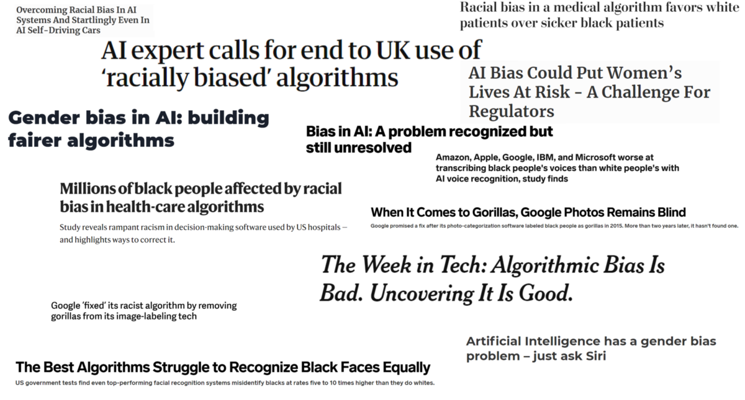
Machine learning systems often demonstrate discriminatory behavior
Historical biases in training data often cause such discrimination!
Notes:
A lot of our daily activities rely on machine learning systems- systems that generate predictions. For example, a credit card application predicts if an applicant is creditworthy.
These systems are data-driven, meaning they are designed to learn patterns from data. Since data can contain historical biases, these systems can also learn to replicate these biases, such as gender or racial discrimination. And of course, as data management researchers, this is a relevant concern for us.

Slide 3
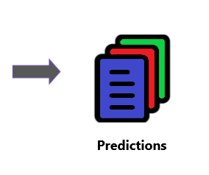
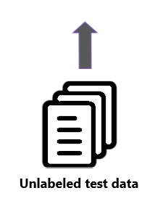
Classification, a machine learning task, is susceptible to similar kinds of biases
Notes:
In particular, our work focuses on classifiers, a ML system that is widely used and is vulnerable to biases I just mentioned.

Slide 4
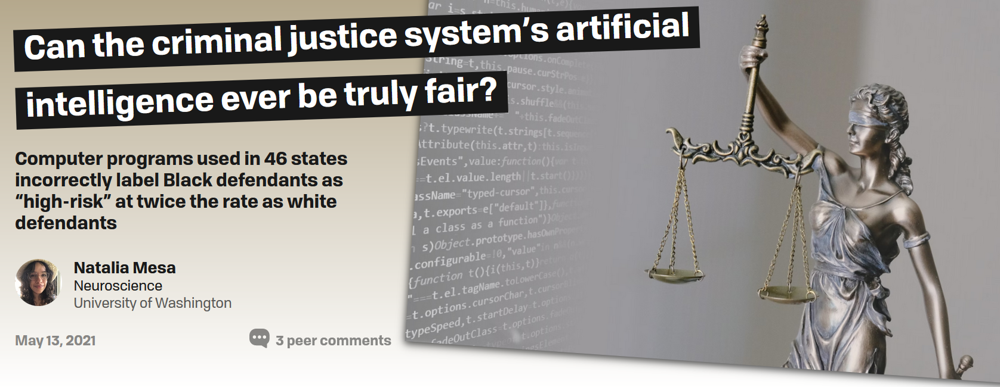
Classification, a machine learning task, is susceptible to similar kinds of biases
Case in point: COMPAS recidivism tool
Notes:
For example, the US courts use a tool called COMPAS to predict if a defendant is likely to commit another crime in future.
An investigation in 2016 revealed that COMPAS is racially biased-
a black defendant is twice more likely to be labeled as “high-risk” even though they are actually not.
And unfortunately, COMPAS is just one of many reported incidents of classifier biases.

Slide 5
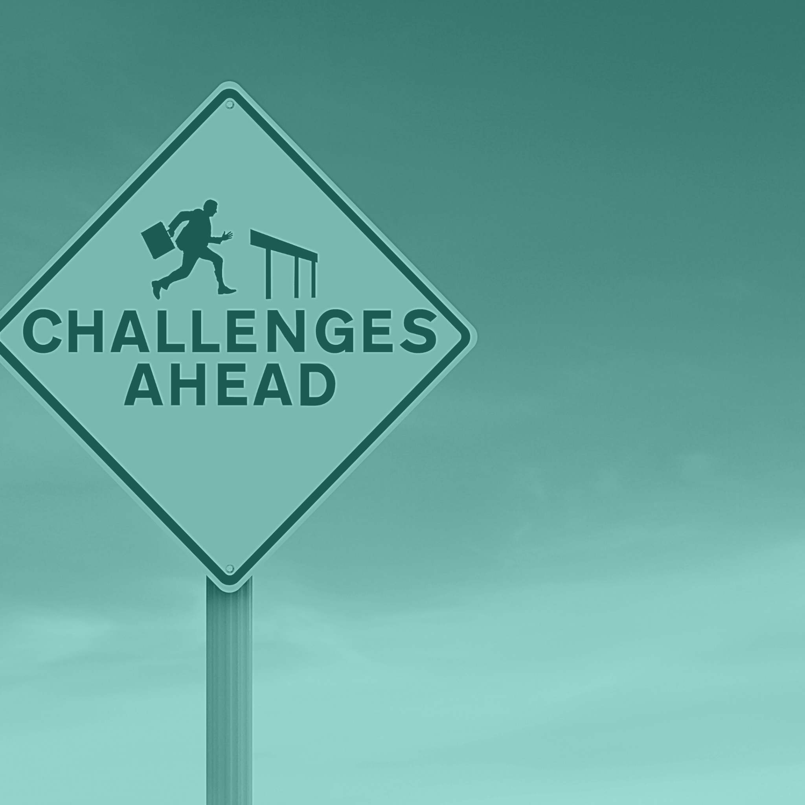
A new set of fair classification algorithms and their challenges
Classification algorithms can be modified to behave fairly.
However, they also present two challenges:
How to choose an appropriate definition of fairness?
What technique to use to incorporate fairness into a classifier?
Notes:
These issues of classifier discrimination sparked a lot of interdisciplinary research in developing so called “fair” classifiers- classifiers that can behave fairly.
But this also presents two new challenges.
First, fairness is very subjective and it can be seen from many different perspectives. So how do we even know what definition of fairness is most appropriate?
And second, there can be many ways to incorporate fairness into a classifier (we will discuss more on this later on). Now how do we pick the best technique for us? The answer to both these questions is that, it depends. And the main objective of our work is discussing what these decisions depend on.

Slide 6
How to choose an appropriate
definition of fairness?
Notes:
So let’s start by discussing more the first challenge, which is choosing the right definition of fairness.

Slide 7
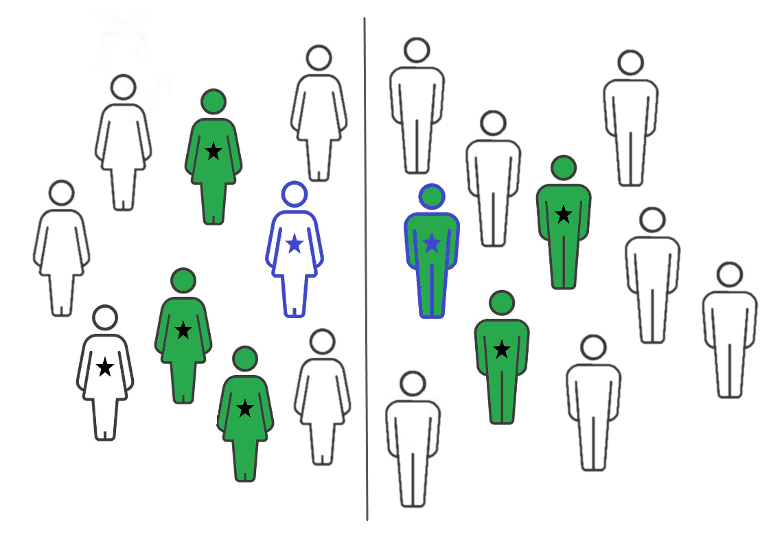
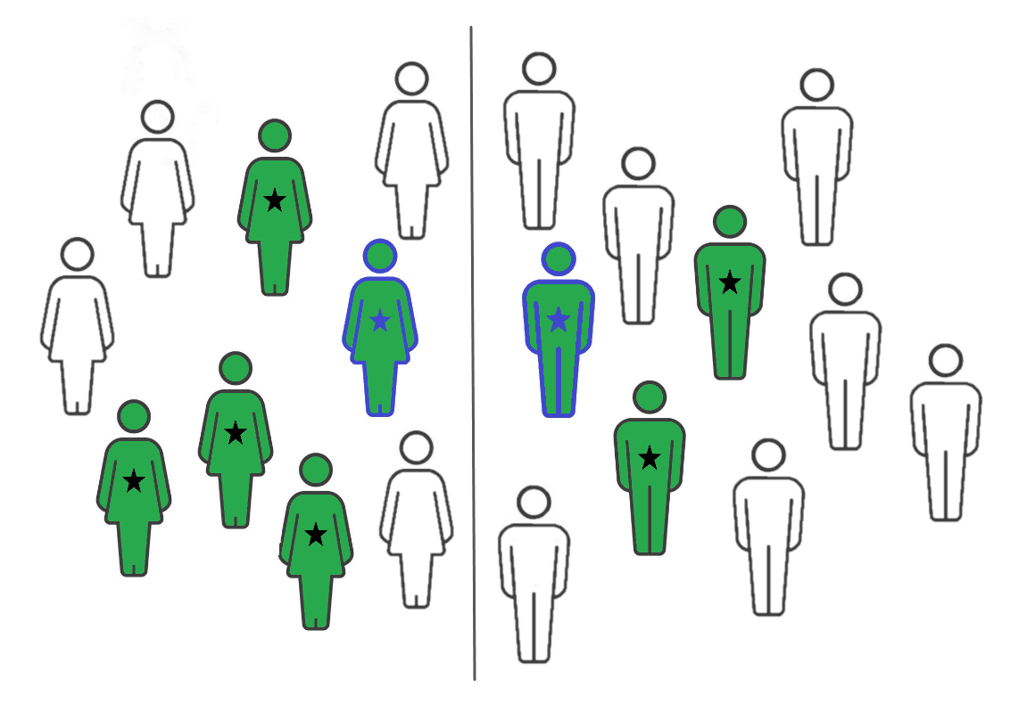
Fairness is subjective, non-trivial, and there is no one-size-fits-all definition
★ means qualified, Green means hired
Female
Male
Female
Male
Ava Leo
Ava and Leo are twins with similar qualifications
and they decided to apply to the same job…
If we ensure group-level fairness through equal gender representations…
Leo is hired but Ava is not!
Individual fairness ensures all similarly qualified individuals like Ava and Leo are hired.
Now gender representations are out of balance!
Notes:
Why is it difficult to choose the right notion of fairness?
Let’s see that with an example..
Let’s say Ava and Leo are twins with identical qualifications, and they applied to the same job.
Consider that we want to ensure all gender groups are treated fairly, so we hire an equal number of male and female candidates.
Since there are only 3 qualified males, we hire everyone including Leo But… Ava is rejected because other female candidates are more qualified than her and we cannot hire more than 3 to keep gender balance
So even though Ava and Leo are identical, they are treated differently, which results in discriminating Ava.
On the other hand, we can choose individual-level fairness and only care about similar individuals being treated similarly.
So Ava and Leo both get hired, along with others. Now you can see that we hire 5 from females, but 3 from males. So equal gender representation is lost and males as a group become under-represented.
This shows us that fairness can be defined from many angles, and they offer different guarantees. Some notions can guarantee that an equal number of candidates are hired from each group, while others guarantee that individuals with identical qualifications are treated equally regardless of their race or gender.

Slide 8
The explosion of fairness notions makes it very difficult to choose the right one
It is very hard to choose from so many options for fairness notions.
We organize notions for easy and informative comparison!
First Contribution
Notes:
Because fairness is so subjective, there have been many many different definitions proposed in literature,
which makes it very hard to pick the right one without a systematic comparison.
This brings us to the first contribution of our work:
we propose an informative categorization of fairness notions to enable easy comparison among them.

Slide 9
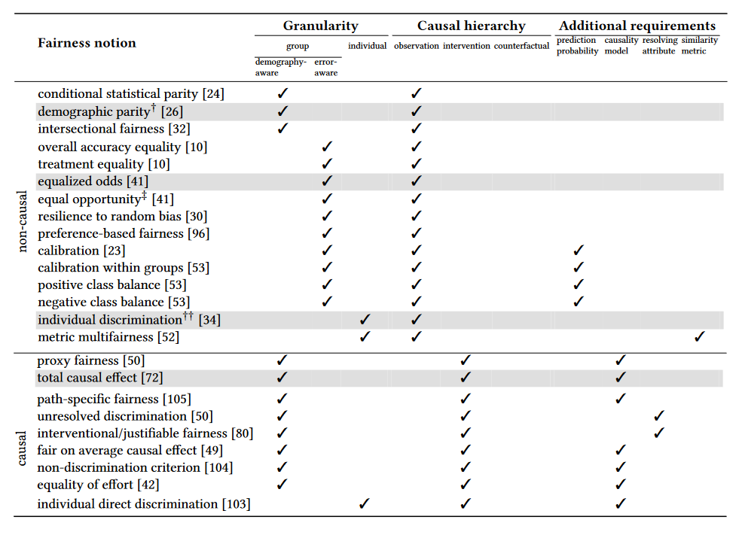
We propose an Informative categorization of fairness notions
Our categorization highlights practical concerns
What level of granularity do we care about?
Notes:
On the left is an example of our categorization of existing notions
Due to time constraints, I’ll just discuss one aspect of it
Our categorization makes it easy to compare many practical concerns. For example: what level of granularity do we care about in our target population?
Do we want to ensure that a group is collectively treated fairly? Like males and females in our previous example. Or, do we care about what outcome each individual gets and ignore their group? Like Ava and Leo.
And there are many more practical questions, such how much domain knowledge do we need, are there additional requirements we need to fulfill before using a particular fairness notion, etc. that we can answer from these categorizations. Please look at our paper for more details!

Slide 10
Which technique to use to
incorporate fairness into a classifier?
Notes:
Now, let’s assume that you’ve somehow decided which fairness notion you’d like to use. And that’s great! The next question that you’re probably thinking about is, how do you make sure your classifier is maintaining the fairness notion you chose. Somehow, you need to tell the classifier how to make fair predictions.
This brings us to the second challenge, which is picking the right technique to enforce fairness in a classifier.

Slide 11
Fair classification approaches can vary across two dimensions
Stage of ML pipeline
Where to apply fairness notion?
Reject option
classifier (Kamiral et al.)
Equalized odds post-
processing (Hardt et al.)
Randomized post-
processing (Pleiss et al.)
and many more…
Fairness-
constraints (Zafar et al.)
Rich sub-group
fairness (Kearns et al.)
Adversarial
debiasing (Zhang et al.)
Meta-fair
algorithm (Celis et al.)
Seldonian classifier
(Thomas et al.)
Reweighing (Kamiran et al.)
Optimized pre-
processing (Calmon et al.)
Which fairness notion to target?
Fairness notion
Notes:
Fair classifiers vary across two dimensions.
The first dimension is the specific definition of fairness that a classifier follows. This is something we discussed earlier. Also, not all classifiers can support all fairness notions. So we have to be mindful of this when picking out a classifier.
Moreover, classifiers can vary from each other depending on which stage of the ML pipeline actually enforces fairness. This is the second dimension and a very important one.
Similar to before, these dimensions or choices have led to an explosion of fair classifiers in literature.
So now you might be wondering, what exactly are these stages? Let’s discuss that a bit.

Slide 12
Fair classification techniques: pre-processing
Modifies data before training to remove biases
Notes:
We have 3 stages and pre-processing is the first one. Pre-processing is the stage before training. It means that we don’t touch the model or predictions, rather modify the training data to remove biases. It’s sort of like the garbage in garbage out principle, the less garbage or bias we feed into the model, the fairer it will be.
Sometimes modifying data like pre-processing techniques may be restricted, because of many reasons like legal or privacy concerns. So what can we do in that case?

Slide 13
Fair classification techniques: in-processing
Constrains a classifier’s objectives during training
Notes:
We can use in-processing. Unlike pre-processing, in-processing techniques assume that they have control over the model training phase.
So they modify the training algorithm to not just optimize accuracy (which is the traditional objective of a classifier), rather (sort of) tell the classifier that.. "hey, we need to look out for fairness too, or even better, we should optimize both fairness and accuracy as much as possible".

Slide 14
Fair classification techniques: post-processing
Modifies predictions after training to achieve fairness
Notes:
The last way to ensure fairness is to do post-processing over the predictions made by a classifier. This is somewhat a lazy technique, because all we need to do is to modify the predictions until they are fair and we’re done! This is typically used when we don’t have access to the data or the model, so we don’t have the capacity to do much and have to resort to superficially altering the predictions. And as you might have guessed, post-processing is limited in the type of fairness notions it can support.
One last thing I’d like to note here is that, there are more fine grained aspects within each type of techniques, but we did not discuss them due to limited time.

Slide 15
The tradeoffs among fair classification techniques are not well-studied
No detailed empirical study exists in literature.
We empirically analyze and compare the fair classifiers!
Second Contribution
Notes:
Each type of technique we discussed so far has different advantages and disadvantages over one another.
But, there is no empirical study in the existing literature that evaluates their tradeoffs
So we don’t really know how good/bad a technique is, compared to others in practice and over different types of datasets.
This is where our second and main contribution lies: we empirically investigate a variety of available fair classification techniques and contrast them on a level-playing field!

Slide 16
We conduct a systematic analysis of fair classifiers from a practical standpoint
18 fair classifiers
7 variants of pre-processing
8 variants of in-processing
3 variants of post-processing
18 fair classifiers
7 variants of pre-processing
8 variants of in-processing
3 variants of post-processing
3 real-world datasets
Adult: 45K #datapoints, 9 attributes gender inequality in annual income
COMPAS: 7.2K #datapoints, 3 attributes racial bias in detecting recidivism
German: 1K #datapoints, 9 attributes
gender bias in assessing credit worthiness
3 real-world datasets
Adult #datapoints: 45K
gender based income inequality
COMPAS #datapoints: 7.2K
racial bias in detecting recidivism
German #datapoints: 1K gender bias in assessing credit worthiness
Practical data management concerns
How much correctness do classifiers trade off while enforcing fairness?
How efficient and scalable the approaches are, especially when data grows vertically/horizontally?
Does the choice of ML model matter for pre- and post-processing?
What happens if the training data has errors?
Notes:
We chose 18 techniques that span the 3 stages and cover a variety of fairness notions.
We examined their behavior on real-world datasets, ranging from 1-45 thousand data points and 3-9 attributes, and also representing gender and racial biases.
And we asked relevant, data management centric questions. Such as.. To ensure fairness, how much accuracy do classifiers sacrifice?
How scalable are the techniques when data grows vertically or horizontally?
What happens if training data is noisy? …and so on and so forth.

Slide 17
What did we observe in our experiments?
Notes:
By now, you must be wondering what interesting insights we have. Let’s dive right into them!

Slide 18
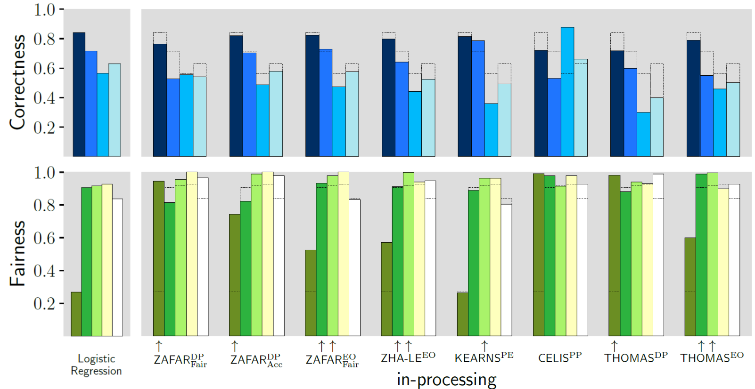
Correctness and fairness tradeoff
A variety of
correctness and fairness metrics
Fair approaches trade accuracy
for fairness
Notes:
The first thing we looked at is the potential tradeoffs of enforcing fairness. We measured the correctness and fairness of predictions through a variety of metrics. We have different fair classifiers on the x-axis and the metrics on the y-axis. The top half of the figures depict correctness metrics, such as accuracy. And the bottom half covers different fairness metrics, like group and individual fairness we saw before. The higher the bar, the more correct or fair the approach is. To have a common baseline that we can compare all fair classifiers to, we also have a plain fairness-agnostic classifier that doesn’t try to ensure fairness. This baseline is overlaid on each fair classifier, so we can easily compare what changes are happening in a fair classifier.
The first thing we notice is that, fair approaches compromise accuracy, as evident from the gap in each bar and its overlay. A plain classifier just cares about maximizing accuracy, right? A fair classifier is constrained because it has to balance both fairness and accuracy. So if we do things like… data repairs or optimizing accuracy under fairness constraints, the drop in accuracy is a natural consequence.

Slide 19
Correctness and fairness tradeoff
A variety of
correctness and fairness metrics
Bigger compromise in accuracy if target fairness is low in a fairness- unaware classifier
Notes:
We also find that the compromise is bigger if the baseline is very far from being fair. This is because a fair classifier has to significantly alter the predictions in such situations, to achieve the desired amount of fairness, which obviously results in hurting accuracy.

Slide 20
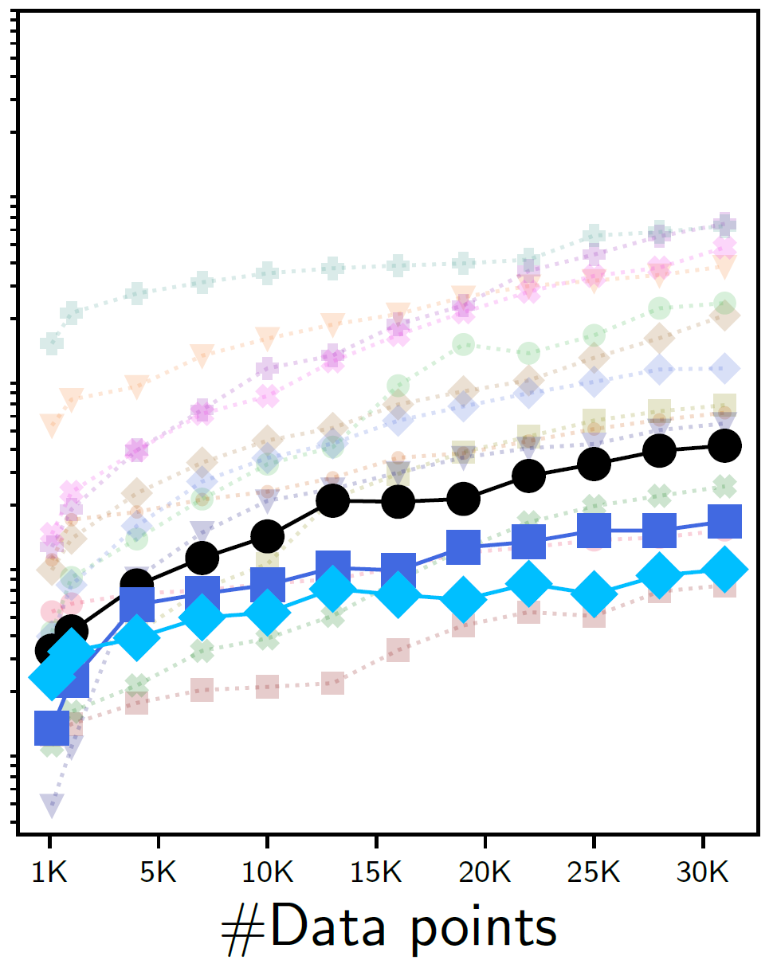
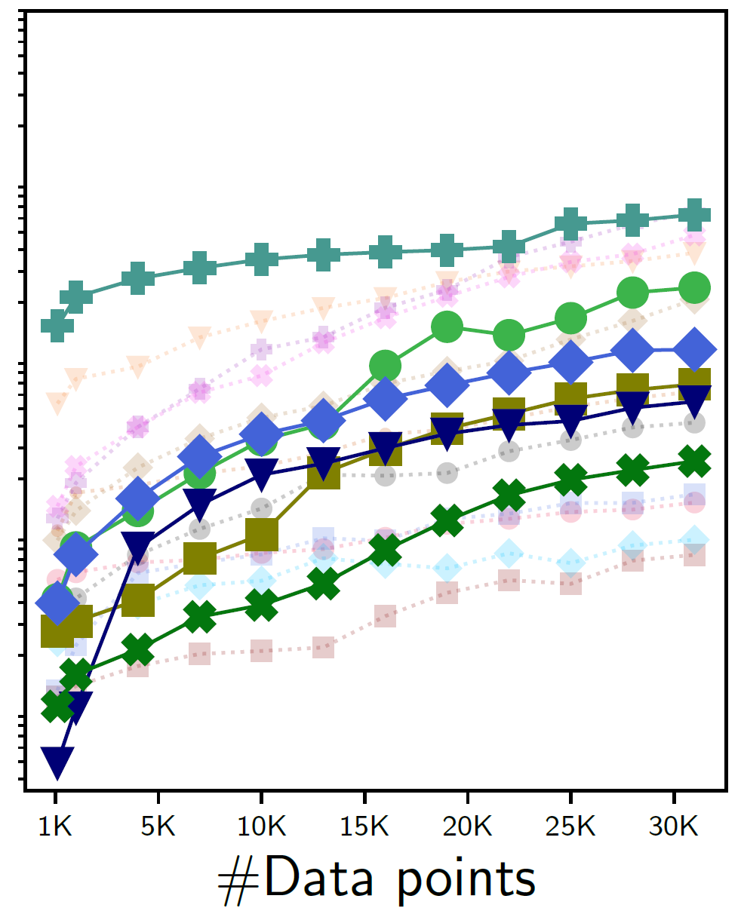
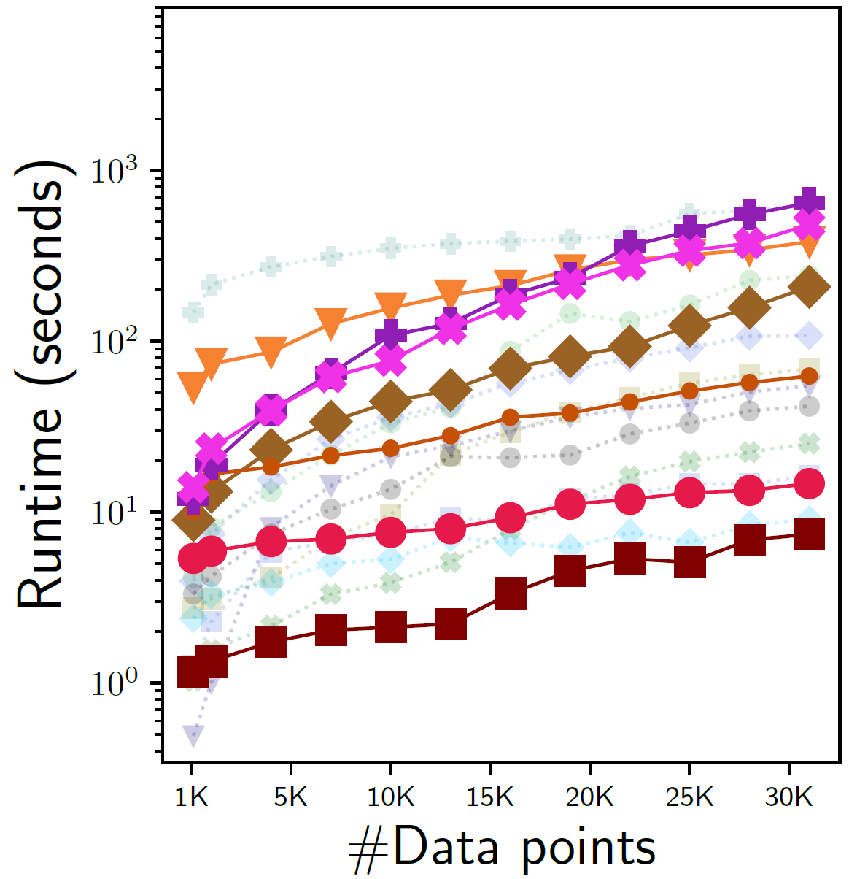
Efficiency gap among techniques: how increasing #datapoints affect runtime?
Post-processing are most efficient due to inherent simplicity
Pre-processing
In-processing
Post-processing
Notes:
So we learned that classifiers typically deliver on their promise to be fair. And that’s great! Very important question that might be on your mind is, how efficient are the classifiers in delivering fair predictions? Especially when you have a large amount of data..
To answer that, we did a scalability test. We measured the runtime of each approach with increasing number of training datapoints to see how scalable the approaches are when data grows horizontally. Note that we are only showing the overhead here. In the figure, we have the number of data points on the x-axis and the runtime on the y-axis. Our findings suggest that post-processing is the most scalable one. Post-processing happens at a very late stage and only modifies the predictions on the fly. This is hardly affected by the size of the training data.

Slide 21
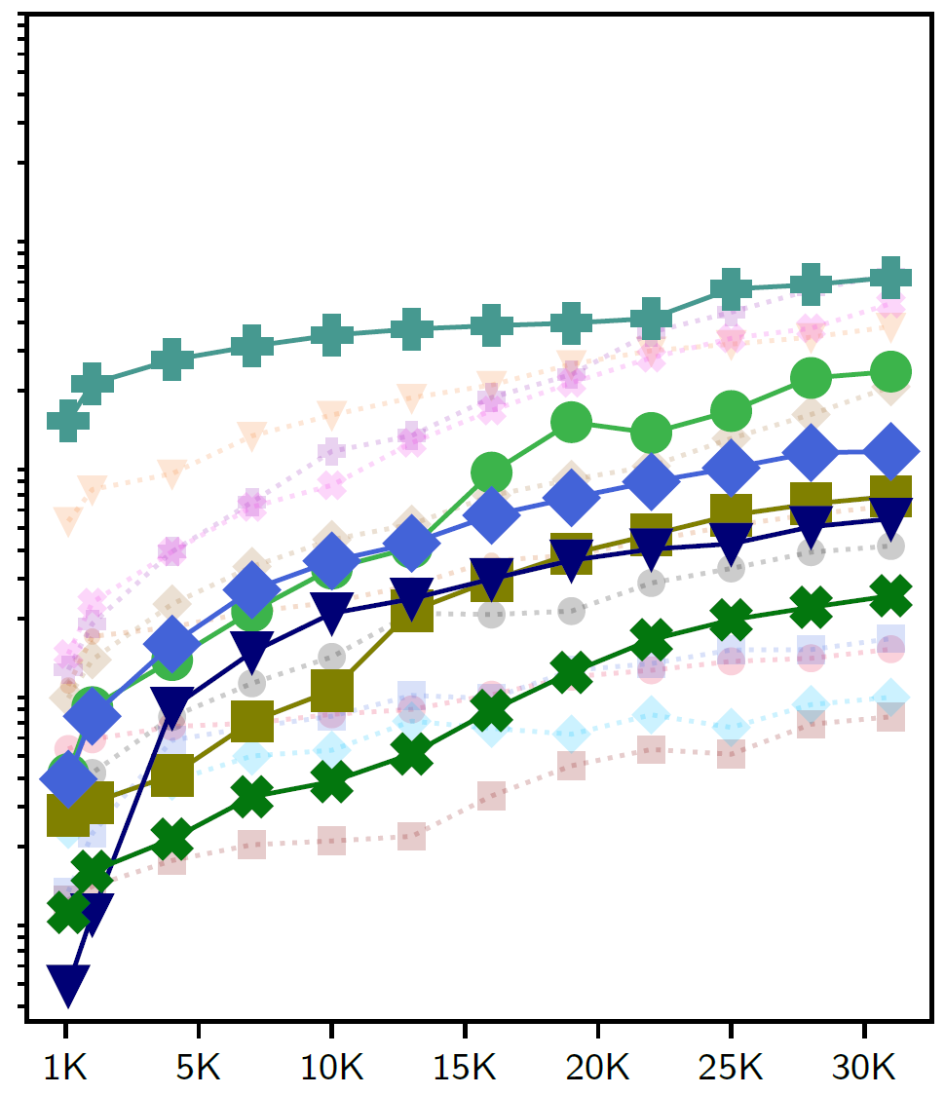
Efficiency gap among techniques: how increasing #datapoints affect runtime?
Complex mechanisms can lower efficiency, commonly observed in pre- and in-processing
Pre-processing
In-processing
Post-processing
Notes:
However, pre- and in-processing are usually more involved to repair data or retrain model, which can lower their efficiency as the data grows.

Slide 22
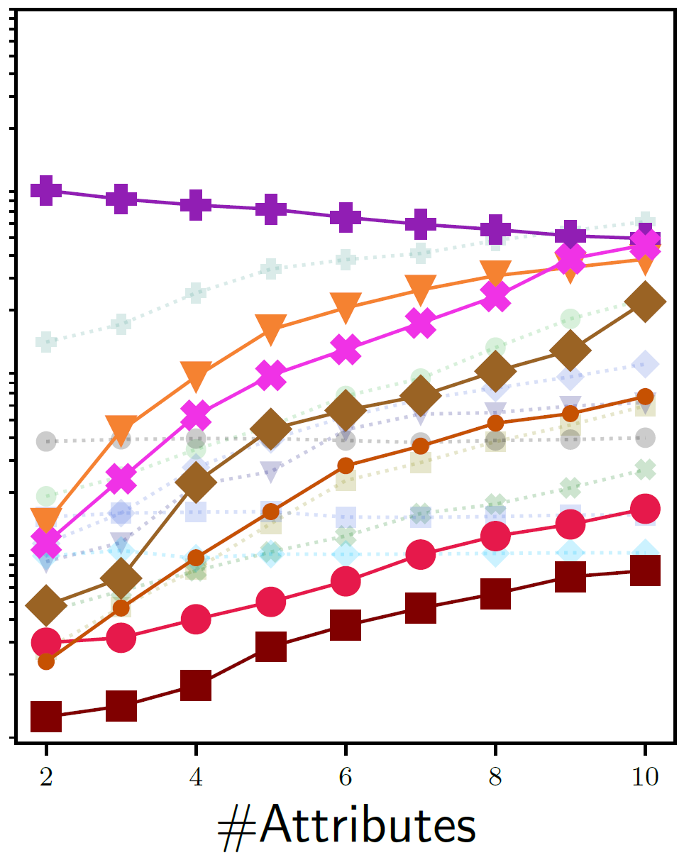
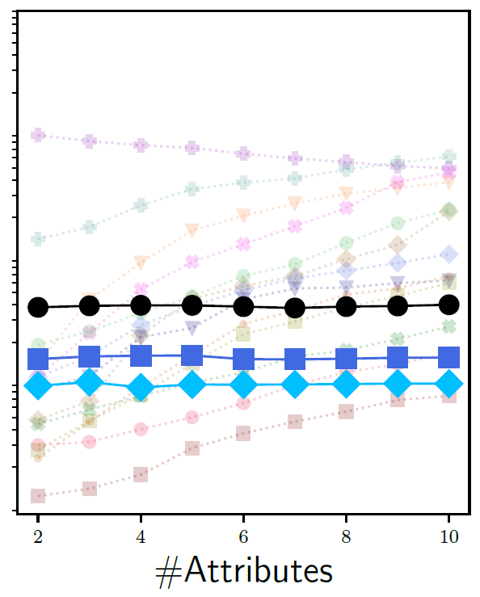
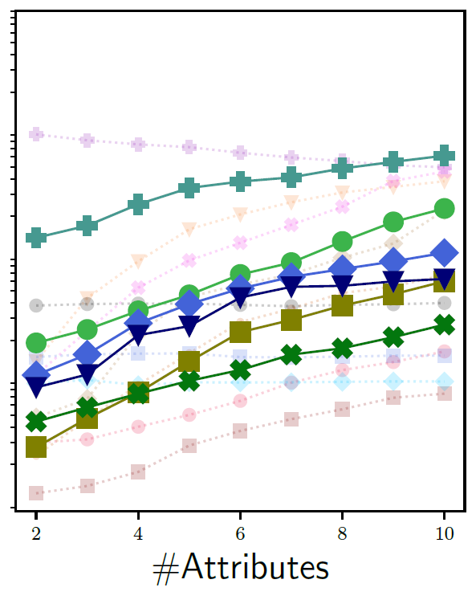
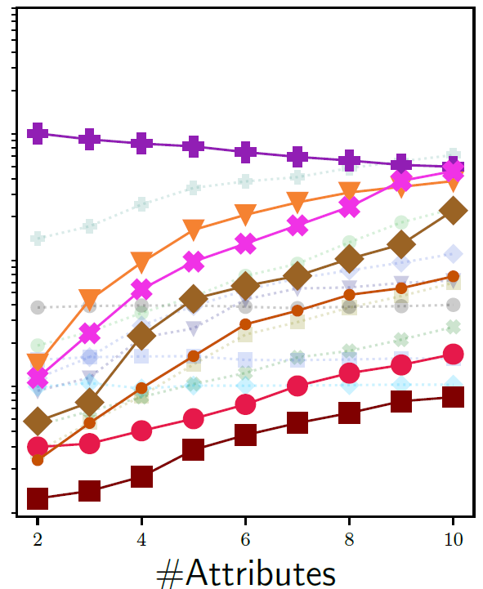
Scalability challenges in pre-processing: how increasing #attributes affect runtime?
Scalability of pre- processing is more hurt by #attributes than #datapoints
Pre-processing
In-processing
Post-processing
Notes:
Now that we’ve seen how classifiers behave with increasing datapoints, a related concern here is what happens when the data is very high-dimensional? To test that, we did another scalability test to observe how the vertical growth of data affects the fair classifiers. We measured the runtime of each approach with increasing number of data attributes. We find pre-processing often exhibits scalability issues. This is because pre-processing approaches tend to do complex repairs per attribute, and the complexity of that repair tends to grow exponentially as we add more and more attributes. We also observed similar behavior in in-processing but less prominently.

Slide 23
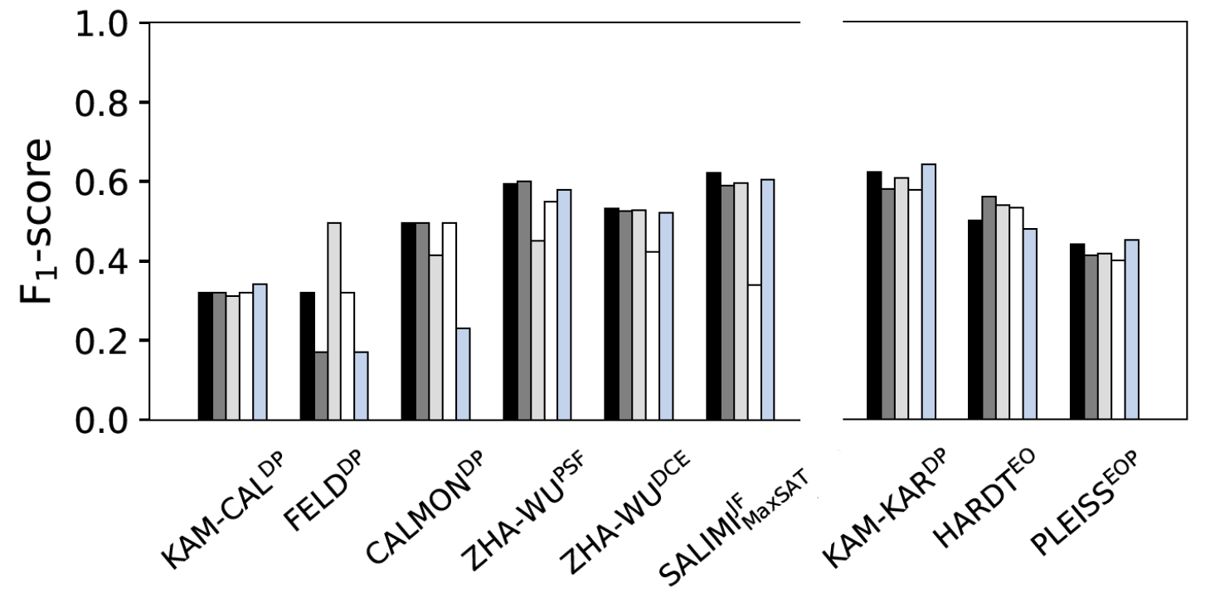
The choice of classifier model for pre- and post-processing
We retrain classifiers with different models
Post-processing is stable as it only modifies predictions after training
Pre-processing
Post-processing
Notes:
Aside from scalability, a separate question that comes to mind is how important is the choice of ML model? By now you already understood that pre- and post-processing are paraded as model-agnostic because their repair mechanisms don’t depend on the specific classifier model being used. But is that really true?
We decided to test whether the choice of model has any effect on the techniques. We retrained each pre- and post-processing approach with different models. I’ll briefly touch on some interesting findings due to limited time. Similar to before, x-axis represents each classifier and y-axis denotes F1-score, a correctness metric. As you might have guessed, we found that post-processing remains unaffected, because it modifies predictions on top of the trained classifier and can control how much to modify the predictions.

Slide 24
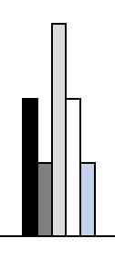
The choice of classifier model for pre- and post-processing
We retrain classifiers with different models
Pre-processing
can fluctuate depending on model
Pre-processing
Post-processing
Notes:
On the other hand, pre-processing has no control over how the repaired data affects a classifier model and can cause varied performance across different techniques.

Slide 25
Our paper has many more interesting insights
Evaluating broad range of 18 fair classifiers
7 variants of pre-processing
8 variants of in-processing
3 variants of post-processing
Utilizing 3 real-world datasets
with different biases
Adult #datapoints: 45K
gender based income inequality
COMPAS #datapoints: 7.2K
racial bias in detecting recidivism
German #datapoints: 1K gender bias in assessing credit worthiness
Examining practical concerns
for data management community
How much correctness do classifiers trade off while enforcing fairness?
Are all approaches efficient and scalable, especially when data grows vertically/horizontally?
Does the choice of ML model matter for pre- and post-processing?
What happens if my training data has errors?
Pre- and in- processing can fail to build fair models if training
data has errors
Notes:
I hope by now you’ve become really invested in our work, because are many more interesting observations that we couldn’t discuss due to limited time. For example, we found that pre- and in-processing approaches can fail to build fair models if the training data contains too many errors. Please take a look at our paper if you’d like to know more of these interesting facts!

Slide 26
What did we learn from our experience?
Pre-processing presents immense opportunity for data
management research, especially in tackling scalability
challenges we observed
Effort into combining fairness concerns with data
cleaning can give pre-processing practical advantages
There is huge potential for synergy with ML research in
addressing scalability issues or optimal model choices
Notes:
To summarize what we’ve discussed so far: Our work is an empirical evaluation of fair classification techniques. To the best of our knowledge, this is the first wide-scale study to conduct such experiments from a data management-centric view.
I’ll finish off with 3 most important lessons.
First, pre-processing techniques of data manipulation are a natural fit for the data management community. But they also present scalability challenges like we observed. This creates a unique opportunity as tackling scalability challenges is a strength of data management research.
Second, we briefly saw that data errors can cause fair models to fail. So there is a good opportunity to integrate fairness concerns into data cleaning methods, which is again a particular strength of data management research. This can give pre-processing more viable in practical settings.
Third, there is a lot of untapped potential for synergy with ML research, to combine the best of both worlds in handling scalability issues, picking the best/optimal downstream model, etc.
With that, I’d like to conclude my talk. Please read our paper for more in-depth analysis.

Slide 27
Questions?
Contact: annafariha@microsoft.com
Notes:
Lastly, thank you for listening so far. If you have any lingering questions, feel free to email me at the following address.

